Slide 1


Slide 2
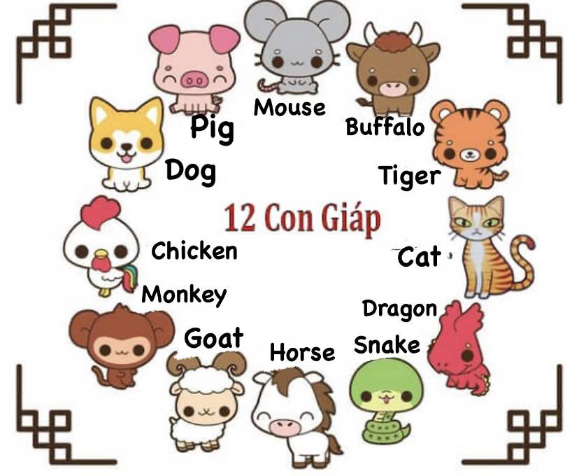
Animals of the year
New year in Vietnam is Tết (Lunar New Year)
Tet is the time to welcome new animal.
There are 12 representative animals. Each animal represents 1 year.
This year 2021 is the year of Buffalo.

Slide 3
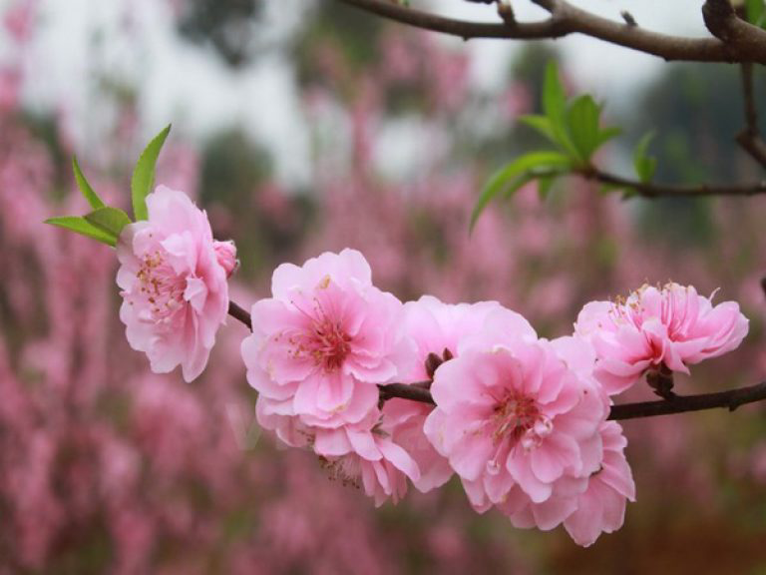
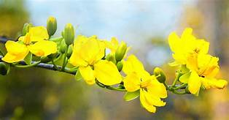
The flower of Tet is Peach flower in the North and Apricot Flower in the South

Slide 4
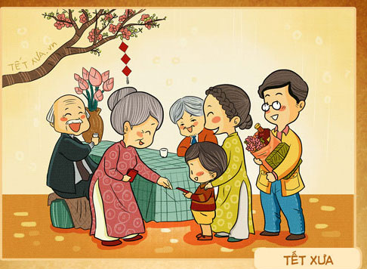
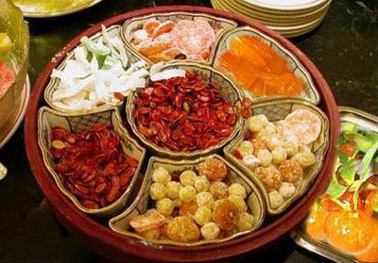
During Tet, we visit our family, friends, neighbours, and we eat traditional sweets.

Slide 5
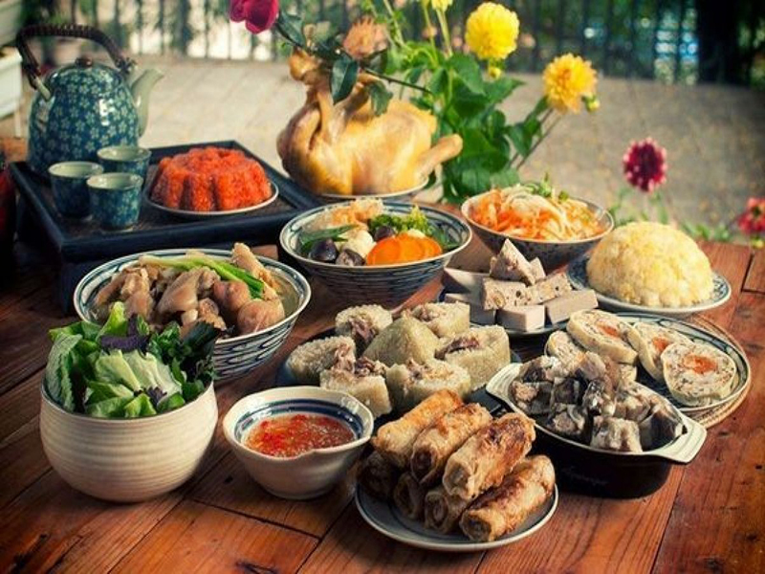
This is a typical meal in Tết. The meal often have “Trưng” cake, Nem (Spring roll), giò (special type of sausage made by Pork), boiled chicken, sticky rice, and soup of bamboo shoots. Fast prepare but delicous and full of energy because we reserve time for visiting each other.

Slide 6
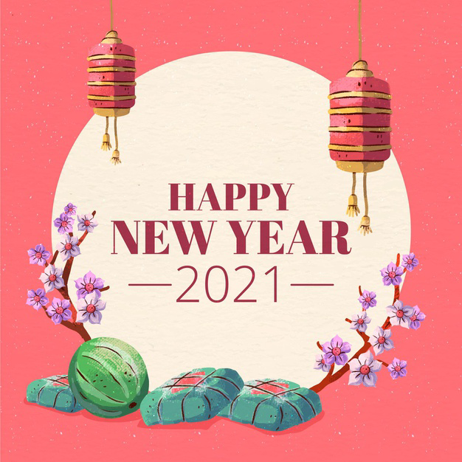
Let’s say:
“Chúc mừng năm mới!”

