Slide 1


Why Vietnam: a Destination for your business success?
5th Edition

Slide 2

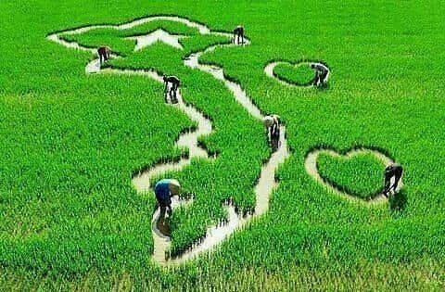
WHY VIETNAM ?

Slide 3
According to the US News and World Report of 2021:
#8 in Best Countries to Invest In (remaining from 2019), based on opinions of more than 6000 business decisions makers on eight different categories:
  Corruption;
  Dynamism;
  Economic stability;
  Entrepreneurship;
  Favorable tax environment;
  Innovation;
  Skilled labour force; and
  Technological expertise
Besides, Vietnam also obtained #12 in Best Countries to Start a Business
and #19 in Open for Business Ranking

Slide 4

ECONOMIC PERFORMANCE
As International Monetary Fund (IMF) 2024:
“The International Monetary Fund forecasts that Vietnam’s gross domestic product will increase by 5.8% in 2024, placing it second in the region.”
As World Bank’s Doing Business 2024: Vietnam has been a development success story. Vietnam ranked 70th (score
↑1.2). Besides, Vietnam has been highlighted in some indexes: Dealing with construction permits (25th, score ↑0.3); getting electricity (27th, score
↑0.3), paying tax (109th, score ↑6.1); getting credit (25th, ↑5 levels)
The European Chamber of Commerce Vietnam (EuroCham) on 8th April, 2024 released the Business Confidence Index (BCI) for the first quarter of 2024, saying that the index reached 52.8 points - the highest level since 2022.
In the 2024 Index of Economic Freedom, the Heritage Foundation notes that Vietnam is one of the rising stars, contrary to the global trend

Slide 5

FASTEST GROWING ECONOMY
PricewaterhouseCoopers (PWC) in The Long View: How will the global economic order change by 2050? states as follows:
“Vietnam … to be … the world’s fastest growing economies [up until 2050].” “Vietnam … could achieve annual average growth of around 5% over the next 34 years.” Vietnam is expected to be world 20th largest economy in 2050 (Korea 18th, Italy 21st, Canada 22nd).
"This positive trend underscores the European business community’s view of Vietnam as a dynamic market with promising growth prospects," said EuroCham Chairman Dominik Meichle (2024)
The Heritage Foundation also cites the level of taxation and public debt as positive features: “The top individual income tax rate is 35 percent, and the top corporate tax rate is 20 percent. The tax burden equals 18.2 percent of GDP. Three-year government spending and budget balance averages are, respectively, 20.1 percent and -1.3 percent of GDP. Public debt amounts to 35.3 percent of GDP.”

Slide 6
INDEX OF ECONOMICFREEDOM
INDEX PARAMETER |  | Vietnam’s 2023 Score (61.2 out of 100)
Rule of Law | Property Rights | 52,6
 | Government Integrity | 36,4
 | Judicial Effectiveness | 40,1
Government Size | Government Spending | 86,5
 | Tax Burden | 78,6
 | Fiscal Health | 88,7
Regulatory Efficiency | Business Freedom | 73,5
 | Labor Freedom | 62,5
 | Monetary Freedom | 70,5
Open Market | Trade Freedom | 79,6
 | Investment Freedom | 40,0
 | Financial Freedom | 50,0
*Source: Heritage foundation

Slide 7
WEF GLOBAL COMPETITIVENESS REPORT 2021
INDEX PARAMETER | 2018-2019 Ranking | 2020-2021 Ranking
Institutions | 89 | 89
Infrastructure | 77 | 79
Innovation Capability | 76 | 71
Business Dynamism | 89 | 93
Market Size | 26 | 31
Labor Market | 83 | 83
Macroeconomic environment | 64 | 77
*Source: WEF Global Competitiveness Report 2021

Slide 8

IN FOCUS by EUROCHAM:
Full member of WTO since 2007
Involvement in the CPTPP & EVFTA
Fast Growing Economy
FDI inflows forecast remains strong
Inflation is at moderate rate
Exchange rates are stable
Political stability
Country risk is at its lowest since the economic crisis
Continued efforts to enhance stability and predictability
region’s preeminent investment destination with Proactive and investor-focused policies
* Eurocham Whitebook 2024

Slide 9
WHY VIETNAM? In short answers:
Political stability and open government for you so that you can only need to focus on your business
Huge work force can satisfy your need and transfer your ideal to reality (Large, skillful and low-cost workforce (highly evaluated by JETRO- Japan)
Huge market for your products and service through domestic and world market with strategic geo-political position:
  → centrally-located to access China and other East Asia & Australasia markets
  Bridge ASEAN and EU with sea port
And you are protected by EVIPA or bilateral investment protection agreement.
Finally, you are welcomed in Vietnam due to complemental economic structure and your value

Slide 10


Viet Nam in your....???

Slide 11
TRADE WITH VIET NAM: business with Vietnam, trade for over the WORLD

Slide 12
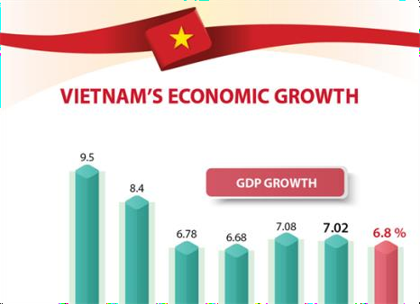
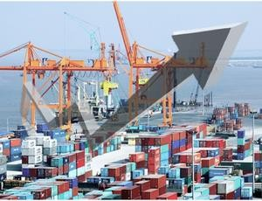
FTA in which Vietnam has joined cover most continents.
COUPLED WITH WTO ACCESSION IN 2007, IMPLEMENTATION OF FTAs CONTRIBUTE TO BOOSTING
GDP up by >300% | Export value up 350%

Slide 13
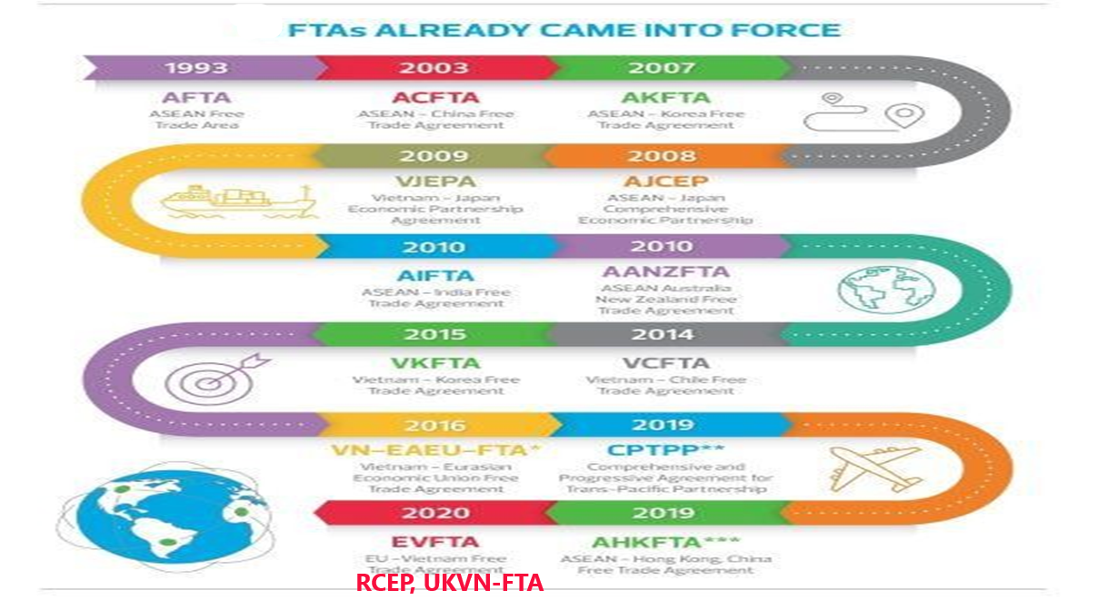
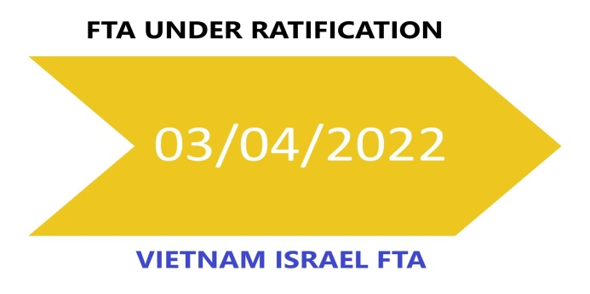


Slide 14
KEY TRADE REGULATIONS
Various regulations:
WTO commitments 2007: Market opening and equal treatment between foreign and domestic investors.
Bilateral / Multinational Trade Agreements
Local regulations for FDI firms, commercial laws, etc.,
Representative Office + Local Agents (invoicing & logistics)
Vietnam encourages the import of
  hi-tech products and items that Vietnam does not produce
  input materials for manufacturing

Slide 15
INVESTMENT INTO VIETNAM: every prepared, every favorable, just for you !!! early birds catch the worm

Slide 16
INVESTMENT LIMITATIONS
Prohibited business lines:
  Trade in the narcotic substances
  Trade in the chemicals and minerals
  Trade in specimensof wild flora and fauna, specimensof rare and/or endangered species of wild fauna and flora
  Prostitution
  Human trafficking; trade in human tissues and body parts
  Business pertaining to human cloning
  Trade in firecrackers
  Debt collection
Conditional business lines: 227 business lines

Slide 17
INVESTMENT LIMITATIONS(CONT)
Foreign ownership cap
Limitations are also imposed on foreign investors in certain sectors in terms of percentage of ownership. For instance:
  The aggregate foreign investment in Vietnamese commercial banks is limited to 30 per cent; and
  ‘Equitisation plans’ for State-owned enterprises undergoing the process of equitisation (ie privatisation) may specify foreign ownership limits

Slide 18
INVESTMENT INCENTIVES
Business lines subjects to investment incentives:
  High technologies and Bio-technologies
  Manufacturing of new materials, new energy, clean energy, renewable
energy
  Manufacturing of IT products, software
  products Collection, treatment, recycling or
  re-use of waste Agriculture, forestry and
  Aquaculture Infrastructure
  Collection, treatment, recycling or re-use of
  waste Education
  Medical
  the Article 15 and 16 of the LOI 2020 for more detail.

Slide 19
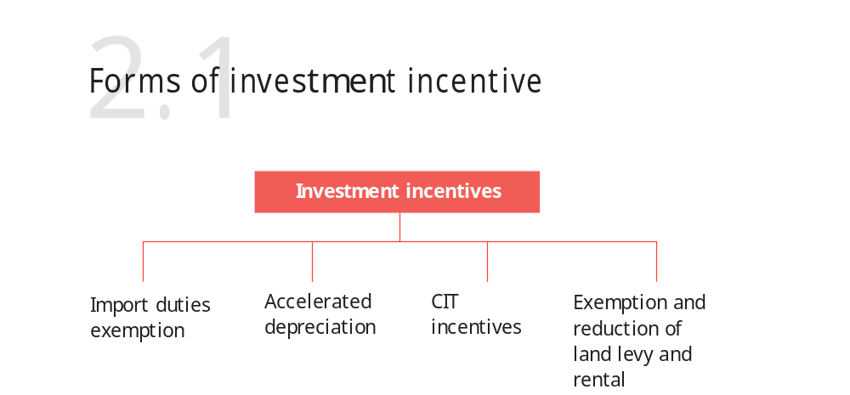
INVESTMENT INCENTIVES(CONT)

Slide 20
INVESTMENT INCENTIVES(CONT)
Forms of investment incentives:
  Corporate income tax incentives: application of a lower rate of corporate income tax; Corporate income tax exemption
  Import tax incentives: exemption from import tax on goods imported to form fixed assets; raw materials, supplies and components for manufacturing purposes in accordance with regulations of law on import and export tax
  Land levy and rent incentives: exemption from and reduction of land levy and land rents
  Deductible expenses: depreciation and increase in deductible expenses upon calculation of taxable income

Slide 21
INVESTMENT INCENTIVES(CONT)
1
Development of technical and social infrastructure inside and outside the investment project
2
3
Training and development of human resources Credit support
Access to business premises and business relocation under decisions of regulatory agencies
Science, technology and technology transfer Market development and information provision R&D

Slide 22
NEW FOCUS IN FDI PROMOTION
Efficiency & productivity optimization is keys for further development
→ Cut down “dirty, low efficiency & low added value” industries in calling for FDI. Focusing onto
Infrastructure
High-quality personnel
Supporting industries
Agriculture
High-technologies

Slide 23
RECENT FAVORABLE POLICIES FOR FDI-1
Foreign ownership in Vietnamese listed companies is limited to 49% instead of 30%.
Foreign ownerships in local banks is loosened:
  Individual investor: 5% cap
  Organizations: 15% cap
  Strategic investors: 20% cap
  Related parties: 20% cap
  Aggregate foreign ownership applicable to commercial banks: 30%
  Aggregate foreign ownership applicable to finance and financial leasing companies: 49%

Slide 24
RECENT FAVORABLE
POLICIES FOR FDI-2
Equitization of SOE:
  Foreign investors are eligible to buy a limited amount of share in an SOE
  Share acquisition are limited to 3 strategic investors
  Strategic investors must hold their shareholding for a minimum of 5 years
Tax allowances:
  CIT reduction from 25% to 22% from Jan 2014
  20% reduction from Jan 2016

Slide 25
INVESTMENT DISPUTESETTLEMENT
Investor-State Dispute Settlement (ISDS)
  Vietnam has signed Bilateral Investment Treaties (BITs) with 64 countries and regions, entered in 15 Free Trade Agreements (FTAs)
Most of these agreements contain ISDS provisions with the
purpose of protecting investors whilst investing in Vietnam.
Vietnam – EU IPA agreement signed in 2019, Vietnam has ratified in 2020 but EU not yet (Luxembourg ratified in 2022 – total 13 MS).
Under Law on Investment 2020, any dispute between investors and Vietnam government related to investment activities can be settled through:
  Vietnam’s court
  Vietnam’s arbitration
  Foreign arbitration
  International arbitration
  An arbitral tribunal established by the parties

Slide 26
FDI ANNEX: ENTRY METHODS
The Law on Investment 2020 applies a “negative-list” market entry restrictions for foreign investors.
Outside of this list, foreign investors are entitled to the same market entry conditions as applicable to domestic investors.
Entry methods:
  Establishment of a enterprise
  Acquisition of, and investment in, an existing enterprise
  Public private partnerships (PPP) contracts
  Business cooperation contracts (BCC)

Slide 27
ENTRY METHODS (CONT)
Establishment of a enterprise
  Foreign investors can set up a new enterprise in Vietnam, whether as a wholly owned subsidiary or as a joint venture with foreign or
  Vietnamese partners.
The investor needs to go through procedures to establish an enterprise to implement the investment project.
  Approval of the investment project is in the form of an Investment Registration Certificate (IRC). Certain types of projects may require an inprinciple approval by the National Assembly, the Prime Minister or the relevant local People’s Committee before the IRC is issued (e.g projects for investment in airports, seaports, petroleum, casinos and golf courses).
  Once the IRC is issued, the investor must then apply for an Enterprise Registration Certificate (ERC) to establish the new enterprise that will implement the investment project.

Slide 28
ENTRY METHODS (CONT)
Acquisition of, and investment in, an existing enterprise
  Investors may also choose to invest in Vietnam by acquiring all or part of an existing enterprise
  A foreign investor is required to obtain the approval for M&A transaction (“M&A Approval”) if the acquisition leads to:
    an increase in foreign ownership in a company engaging in business
lines with market access conditions
    an increase in foreign ownership in a company from 50% or less to more than 50% of charter capital, or a further increase in foreign ownership if it has been more than 50%.
    M&A Approval is also required if the acquisition of a company which has a land use right certificate on an island, a coastal or in another area which affects national defence and security.

Slide 29
ENTRY METHODS (CONT)
Public private partnerships (PPP) contracts
  Foreign investors can invest in public sector projects under public private partnership (PPP) arrangements.
  Law on Public –Private Partnerships dated 18 June 2020. The PPP Law establishes the legal framework for all PPP projects and aims to attract more private investment to the development of Vietnam’s infrastructure.
  Permitted sectors: transportation; power plants and power transmission lines; irrigation works, clean water supply, water drainage and waste water treatment, and waste treatment; healthcare, education and training; information technology infrastructure
  PPP investment models: Build – Operate – Transfer (BOT); Build – Transfer – Operate (BTO); Build – Own – Operate (BOO); Operate – Manage (O&M); Build – Transfer – Lease (BTL); Build – Lease – Transfer (BLT); and mixed contracts combining (a) BOT, BTO, BOO or O&M and (b) BTL or BLT.

Slide 30
ENTRY METHODS (CONT)
Business Cooperation Contracts (BCC)
  A BCC contract is a written contract between investors, agreeing to cooperate to undertake certain business activities and to share the profits or products arising from such activities.
  No separate legal entity or company is established and there is no limitation on liability for participants.
  An IRC must be obtained for BCCs involving foreign investors.
  BCCs have been used mainly in the petroleum and telecommunication sectors.

Slide 31
ANNEX: COMPANY FORMATION
Company forms
  There are three main private company forms for both domestic and foreign-invested enterprises:
    single member limited liability company (SLLC);
    multiple member limited liability company (MLLC); and
    shareholdingcompany, also referred to as a joint stock company (JSC).
  Other less common forms include sole proprietorship and partnership companies.

Slide 32




COMPANY FORMATION (CONT)
SLLC | MLLC | JS C
Investors and the organizational structures
Investors: The sole investor may be an organization or an individual. The organizational structure: Model 1: President and Director; Model 2: Members’ Council and Director | Investors: Two or more investors, limited by fifty investors who may be organizations or individuals. The organizational structure: Members’ Council, President of the Members’ Council, Director or General Director | Investors: Three or more investors (no upper limit) who may be organizations or individuals The organizational structure: Model 1: General Meeting Shareholders, Board of Management, Board of Controllers and Director; or Model 2: General Meeting Shareholders, Board of Management and Director
 | Capital mobilization
Cannot issue shares. Subject to conditions, can issue bonds to raise capital, but not convertible bonds. | Subject to conditions, can issue bonds to raise capital, but not convertible bonds. | Must have ordinary shares and may have preference shares, including voting, dividend, redeemable preference shares and other types stipulated in the charter. Subject to conditions, may issue bonds to raise capital, including convertible bond
 | Transfer of capital
Where an investor transfers only part of the charter capital, the SLLC must register for conversion into an MLLC. The new member must also be registered in the ERC. | An investor wishing to transfer all or part of its capital contribution must first offer to sell such share of capital contribution to all other investors proportionally. Member’s rights and obligations are transferred when the transferee is registered in the members’ registry maintained by the company. | Shares may be freely transferred (unless they are subject to certain limitations on founding shareholders in the first three years, or otherwise restricted under the charter or law). Voting preference shares may not be transferred. The transfer of shares will be completed when the new shareholder is registered in the shareholders’ registry maintained by the company.
voted “Vietnam Corporate Law
The Year”
Copyright ©2013– 2014 VCI Legal All right reserved. This presentation and
its contents are copyrighted under applicable Vietnamese and international laws. Contents of this Presentation, in whole or in part, could not be used without the authorization of the author in writing. Any unauthorized use is subject to be penalized under applicable laws and regulations

Slide 33
COMPANY FORMATION (CONT)
Enterprise Registration Certificate
  An enterprise needs to obtain an ERC upon its establishment. The enterprise has legal personality from the date of issue of the ERC
(equivalent to a certificate of incorporation in other jurisdictions).
  The establishment of a new foreign invested enterprise additionally requires an IRC before an ERC can be issued.
Charter
  All companies must have a charter, (equivalent of a constitution or articles of association of a company in other jurisdictions). The charter sets out basic company details and the rules for management of the company
Legal representative
  The legal representative of a company is the person authorised to represent, and sign documents on behalf of, the company.
  A company may have one or multiple legal representatives. In the latter case, the allocation of power and authority between the legal representatives must be specified in the charter.

Slide 34
COMPANY FORMATION (CONT)
Tax registration and payment of the business license tax
  The businesslicense certificate number is also the company’s tax number.
  All companies must pay taxes through an online system.
Companies
also submit tax declarations and reports through this system. To gain access to this system, businesses must get an electronic signature.
Company’s seal
  Under the Law on Enterprises 2020, an enterprise have the right to determine the type, form, number of its seal
  The management and usage of the enterprise’s seal in
accordance with the charter
Enterprises do not have to register or notify its seal specimen to
Enterprises are allowed to use both physical seals and digital signatures when executing company documentation. The digital signatures will be given the same legal weight with the traditional physical seals
authorities before put it into use

Slide 35
ANNEX
COUNTRY FACT

Slide 36
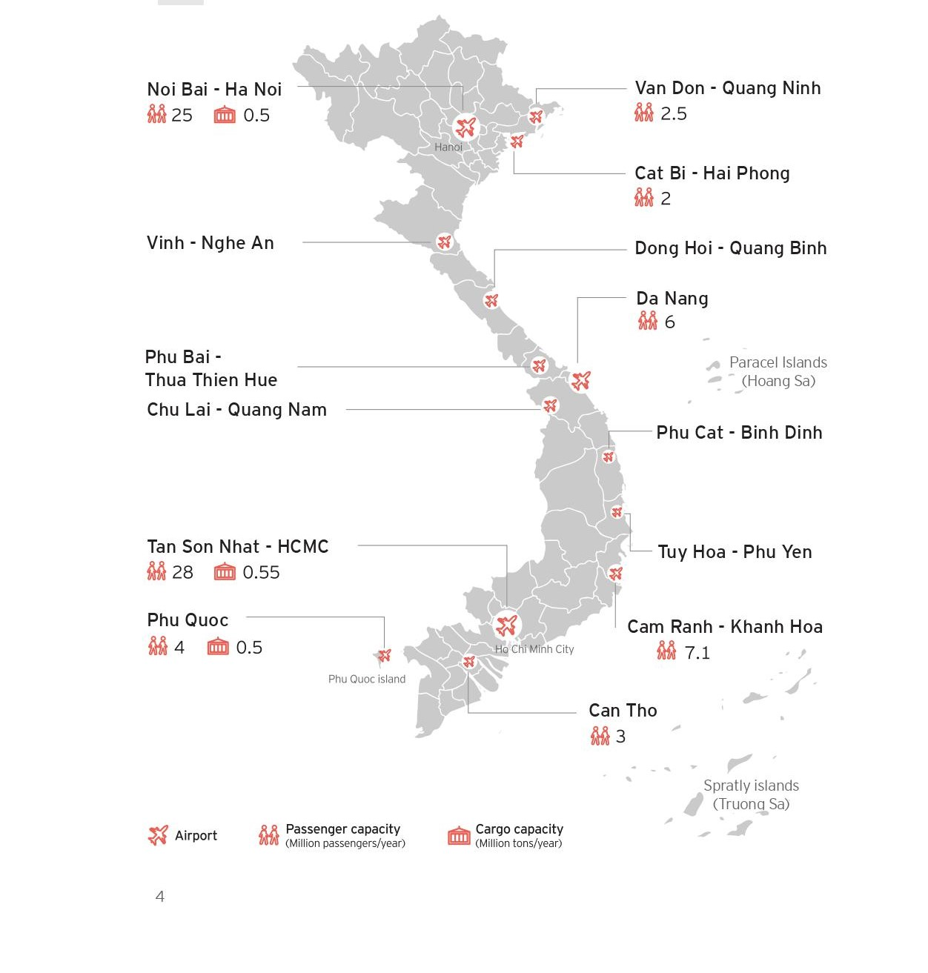
Airport

Slide 37
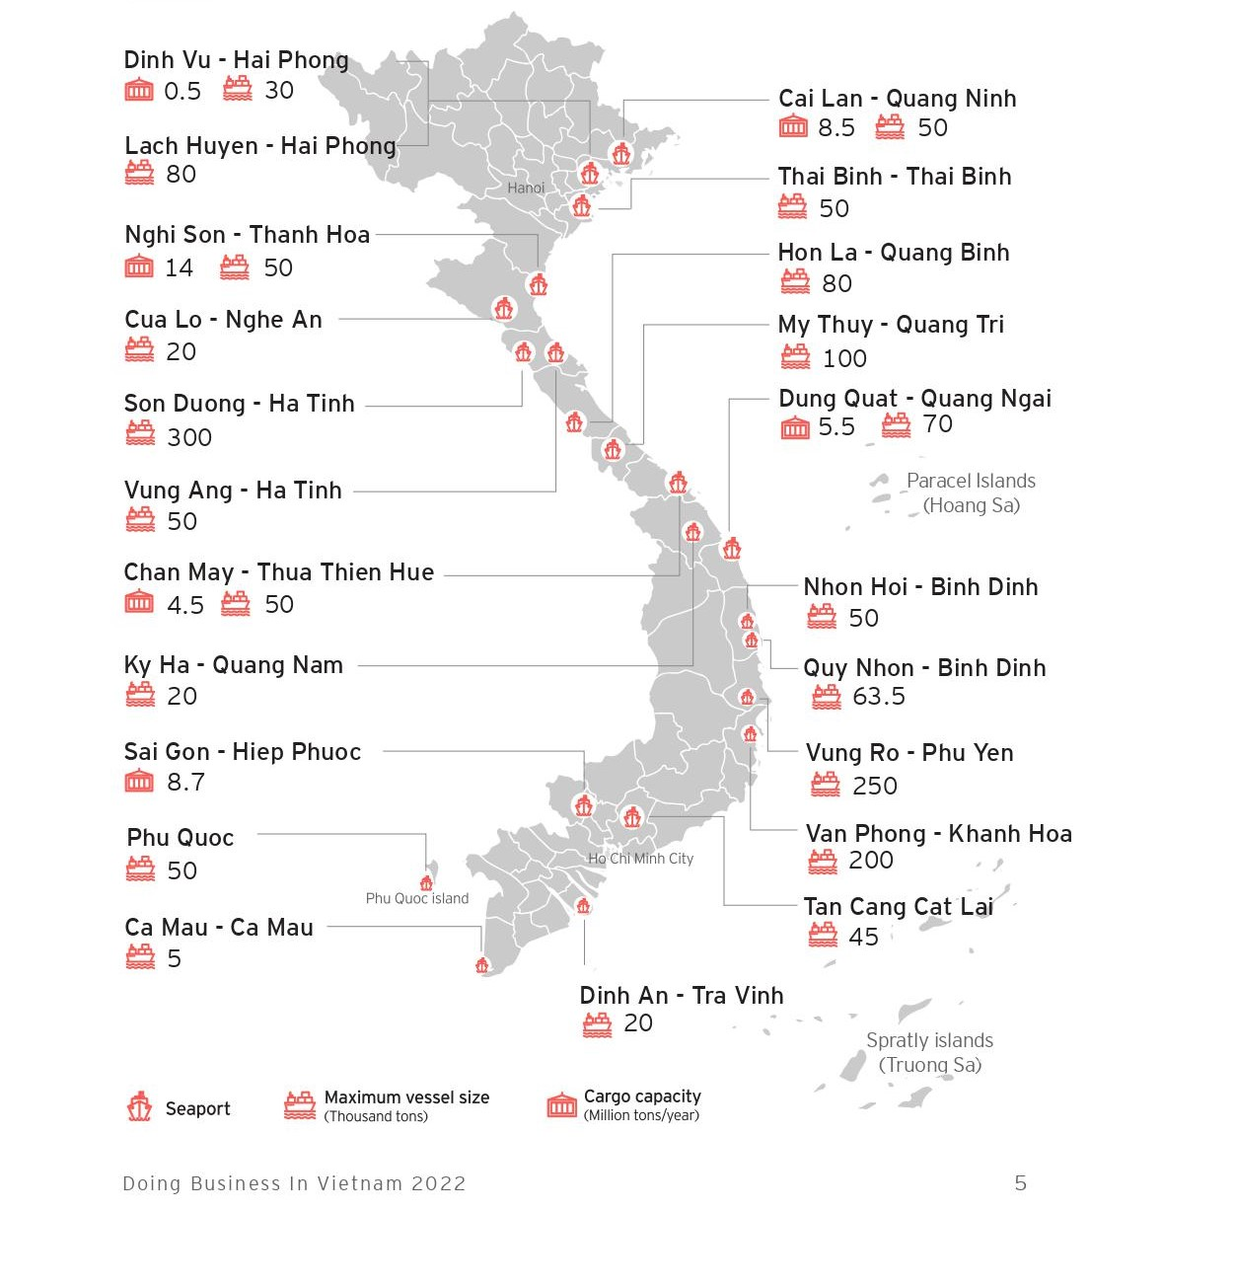
Seaport

Slide 38
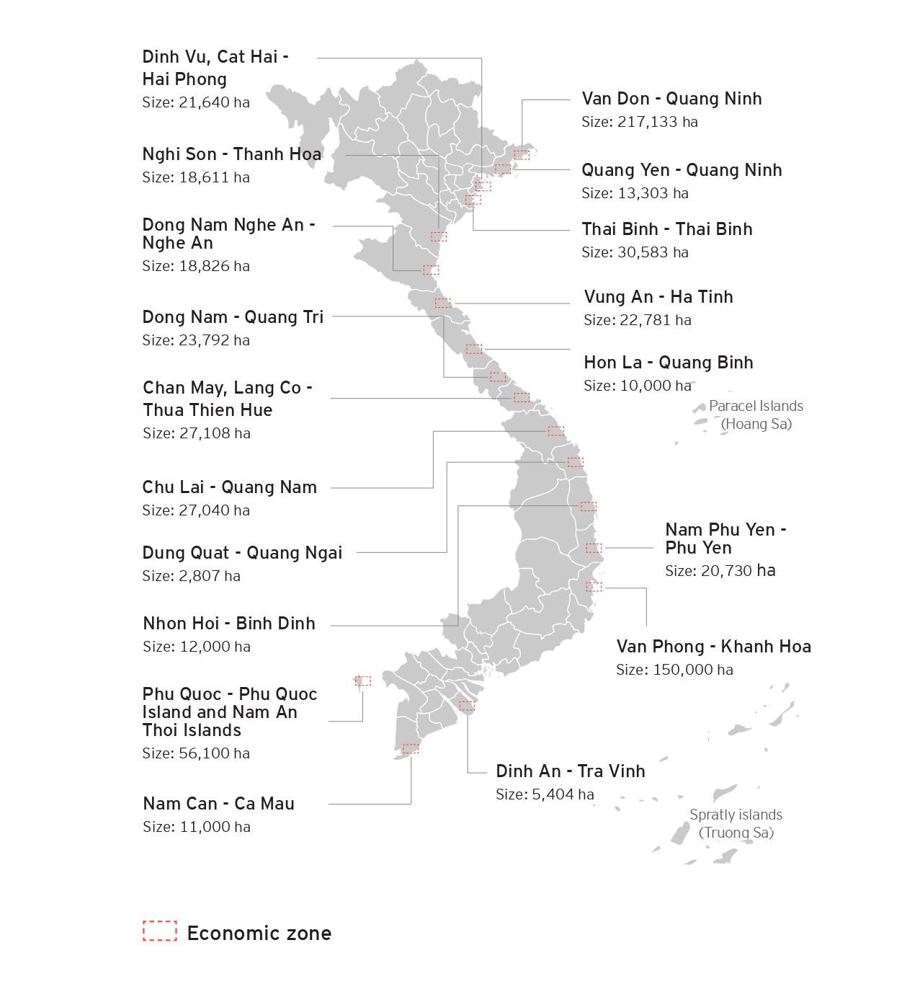
Coastal
Economic
Zones

Slide 39

LAND
Land owned by the People
Land use right (LUR) entitles the exclusively use the land
holder to
LUR Acquisition:
  Lease from State or permitted lessors
  As capital contribution from VN party to a JV
Land Lease duration: 50-70 years
Mortgage and sub-lease of land Impossible but possible to Mortgage and sub-lease LUR

Slide 40
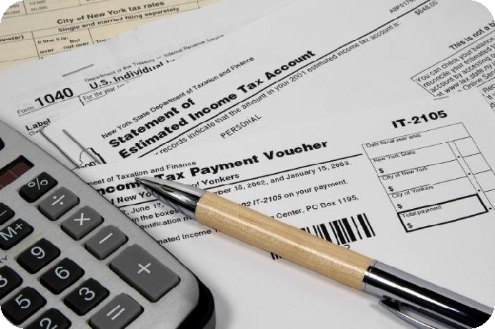
TAXES
Corporate Income Tax (CIT)
  Standard rate 20%
  Tax holiday - CIT exemption
up to 4 years from the date
of issuance of investment
certificate followed by a period of 50% Taxes.
  10% and 20% tax rates for
investments in encouraged sectors
Import and export duties
Investors
meeting certain conditions
are entitled to incentives on import duties for initial fixed assets
Land rental, land usage fees
Applicable to investors with
investments in an
encouraged sector or region
Exemption or reduction from
land taxes, land use fees and
water surface rentals.
Allocation of land with
or
without land use fees

Slide 41

CAPITAL MARKETS & SECURITIES
Foreign Invested Enterprise (FIE) may sell shares to either foreign
or local citizen or entities
FIE sell all its shares to foreigners: Amendment of IC
FIE sells all its shares to local: IC changes into Enterprise Registration Certificate (ERC)
2 stock exchanges: HSX & HNX
Securities law 2006:
USD 480,000 to be listed
Minimum of 100 investors

Slide 42
INTELLECTUAL PROPERTY
IPR system is divided into 3 areas:
  Copyright and related rights- administered by the Copyright Office
of Vietnam
  Industrial Property Rights: administered by the NOIP
  Right to plant varieties: administered by the Plant Variety protection Office
Administrative actions: fines, seizure and destruction of counterfeit
goods, business license suspension and re-exportation of infringed
Civil actions: Preliminary injunctions and compensation for damage
are available through the civil courts
imported, etc

Slide 43
Vietnam's Commitments at COP26
Along with nearly 150 countries, commit to achieve netzero carbon emissions by the middle of this century
Along with more than 100 countries, commit to reduce
global methane emissions by 30% by 2030
Along with over 45 countries, commit to scale up the
deployment of clean power generation, transition away from coal power generation, and cease issuing new permits for coal power generation by 2040
Participate in the Adaptation Action Coalition with 150 countries, commit to reduce greenhouse gas reductions by 9% (with domestic resources) and 27% (with international support) by 2030
Along with 145 countries, signed onto the Glasgow Leaders' Declaration on Forests and Land Use, and committed to end deforestation in Vietnam by 2030

Slide 44
National Strategy on green development period 2021 – 2030 vision 2050
According to the Decision 1658/QD-TTg dated 1 October 2021 on approval for national green growth strategy for the 2021 - 2030 period, with a vision by 2050, the national strategy on green development is to set general objectives and specific objectives for green development as follows:
► General objectives: Green development promotes economic restructuring with growth model innovation, achievement of economic prosperity, environmental sustainability and social equality; strive towards green and carbon-neutral economy and contribute to the reduction of global warming
► Specific objectives are included: Reducing intensity of greenhouse gas emission per GDP; Greening economic Sectors; Greening lifestyle and promoting sustainable Consumption; Greening transition on principles of equality, inclusion, and resilience

Slide 45







Slide 46
CHECKLIST OF DOCUMENTS REQUIRED FOR APPLICATION FOR ESTABLISHMENT OF A 100% FOREIGN INVESTED ENTERPRISE
CLIENT:
ABC CORPORATION (“the Investor”)
THE TO-BE-ESTABLISHED SUBSIDIARY IN VIETNAM (“the Company”)
This Checklist is prepared in accordance with the Vietnam’s prevailing legislation and our verbal discussions with the licensing authorities. Additional documents may be required by the licensing authorities at their discretion during the process of assessment of the application dossiers and we will keep you posted timely.
Each of the documents required below is made into two (02) originals or notarized/legalized copies (one is for submission to the licensing authorities
and one is for the Company’s record retention purpose as required by the laws), except specific requirement in the Checklist.
N o. | Documents | Prepared by | Languages | Signature/Seal requirements | Notes
STEP 1: APPLICATION FOR INVESTMENT REGISTRATION CERTIFICATE (“IRC”) OF THE INVESTMENT PROJECT
 | Application letter for implementation of the investment project | A to provide the draft | English & Vietnamese | INITIALED (on each page) and SIGNED (on the last page) by the Legal Representative or duly authorized signatory of the Investor; and
 |  |  |  | AFFIXED (on the last page) with the seal/stamp of the Investor.
 | Proposal for the investment project | A to provide the draft | English & Vietnamese | INITIALED (on each page) and SIGNED (on the last page) by the Legal Representative or duly authorized signatory of the Investor; and
 |  |  |  | AFFIXED (on the last page) with the seal/stamp of the Investor.

Slide 47
N o. | Documents | Prepared by | Languages | Signature/Seal requirements | Notes
 | Technical and Economic Explanation of the investment project | A to provide the draft | English & Vietnamese | INITIALED (on each page) and SIGNED (on the last page) by the Legal Representative or duly authorized signatory of the Investor; and
 |  |  |  | AFFIXED (on the last page) with the seal/stamp of the Investor.
 | Documents proving the
 | legal status of the Investor:
 | 4.1. Legalized (*) copy of | Client to | Home language |  | 2 legalized copies
 | the Certificate of | provide | (or English) & |  | are required.
 | Incorporation/Certificate |  | certified
 | of Business |  | Vietnamese
 | Registration/Business |  | translation
 | Licence of the Investor
 | 4.2. Legalized (*) copy of | Client to | Home language
 | the Memorandum of | provide | (or English) &
 | Association and Articles of |  | certified
 | Association of the Investor |  | Vietnamese
 |  |  | translation
 | Documents proving financial capability of the Investor
 | 5.1. Report on financial capability of the Investor | A to provide the draft | English & Vietnamese | INITIALED (on each page) and SIGNED (on the last page) by the Legal Representative or duly authorized signatory of the Investor; and
 |  |  |  | AFFIXED (on the last page) with the seal/stamp of the Investor.

Slide 48
N o. | Documents | Prepared by | Languages | Signature/Seal requirements | Notes
 | 5.2. Copy of Audited | Client to | Home language |  | Please provide the original audited Financial Statements if available
 | Financial Statements of the | provide | (or English) &
 | Investor for the latest two |  | certified
 | (02) years; OR Original |  | Vietnamese
 | Confirmation letter of a |  | translation
 | bank proving the sound
 | financial capability of the
 | Investor signed and
 | stamped by the bank
 | Documents relating to the proposed premises of the Company: Original or notarized copy of the Memorandum of Understanding on office leasing or Offer to Lease or Lease Contract; | Client to provide | Vietnamese |  | If landlord is a corporate entity, this corporate entity must have the office lease business function stated in its Certificate of Business Registration.
 | Lessor’s documents related to the leased office: Notarized copy of ID card and Certificate of Business Registration for Household (for individual) or Certificate of Business Registration (for corporate entity); |  |  |  | These documents need to be notarized by a competent Vietnamese authority.
 | Notarized copy of ownership certificate of house/building;
 | Notarized copy of Minutes

Slide 49
N o. | Documents | Prepared by | Languages | Signature/Seal requirements | Notes
 | on construction completion; Notarized copy of the lease contract between the landlord and the lessor (in case the lessor and landlord are not the same); Notarized copy of Certificate of Business Registration of the landlord (in case the lessor and the landlord are not the same)
 | Legalized (*)/notarized copies of Passports of: The Legal Representative of the Investor; The duly authorized signatory of the Investor (if any). | Client to provide | Home language (or English) & certified Vietnamese translation
 | Power of Attorney to sign documents (in case the signatory of the Investor is other than the Legal Representative of the Investor) | A to provide the draft | English & Vietnamese | INITIALED (on each page) and SIGNED (on the last page) by the Legal Representative or duly authorized signatory of the Investor; and AFFIXED (on the last page) with the seal/stamp of the Investor. | U3 originals are required
 | Authorization Letter for A’s staff to act on behalf of the Investor during the licensing process | A to provide the draft | English & Vietnamese | INITIALED (on each page) and SIGNED (on the last page) by the Legal Representative or duly authorized signatory of the Investor; and

Slide 50
N o. | Documents | Prepared by | Languages | Signature/Seal requirements | Notes
 |  |  |  | AFFIXED (on the last page) with the seal/stamp of the Investor.
STEP 2: APPLICATION FOR ENTERPRISE REGISTRATION CERTIFICATE (“ERC”) OF THE COMPANY
 | Application letter for registration of enterprise | A to provide the draft | English & Vietnamese | INITIALED (on each page) and SIGNED (on the last page) by the proposed Legal Representative of the Company.
 | Charter of the Company | A to provide the draft | English & Vietnamese | INITIALED (on each page) and SIGNED (on the last page) by the Legal Representative or duly authorized signatory of the Investor and the Legal Representative of the Company; and AFFIXED (on the last page) with the seal/stamp of the Investor.
 | Decisions of Investor:
 | Authorization letter of the Investor to appoint the Authorized Representative(s) in the Company | A to provide the draft | English & Vietnamese | INITIALED (on each page) and SIGNED (on the last page) by the Legal Representative or duly authorized signatory, and Authorized Representative(s) of the Investor; and AFFIXED (on the last page) with the seal/stamp of the Investor.
 | . Decision of the Investor on appointment of Legal Representative(s) of the Company | A to provide the draft | English & Vietnamese | INITIALED (on each page) and SIGNED (on the last page) by the Legal Representative or duly authorized signatory of the Investor; and AFFIXED (on the last page) with the

Slide 51
N o. | Documents | Prepared by | Languages | Signature/Seal requirements | Notes
 |  |  |  | seal/stamp of the Investor.
 | List of Authorized Representative(s) of the Investor in the Company | A to provide the draft | English & Vietnamese | SIGNED by the Authorized Representative(s) of the Investor in the Company on the signature box; SIGNED by the proposed Legal Representative of the Company.
 | Documents proving the legal status of the Investor: |  |  |  | Provided in Doc. 4 - Step 1
 | 5.1. Legalized (*) copy of the Certificate of Incorporation/Certificate of Business Registration/Business Licence of the Investor; | Client to provide | Home language (or English) & certified Vietnamese translation
 | 5.2. Legalized (*) copy of the Memorandum of Association and Articles of Association of the Investor | Client to provide | Home language (or English) & certified Vietnamese translation
 | Legalized (*)/notarized copies of Passports/Identification Cards of: The proposed Legal Representative(s) of the Company; and The Authorized Representative(s) of the | Client to provide | Home language (or English) & certified Vietnamese translation

Slide 52
N o. | Documents | Prepared by | Languages | Signature/Seal requirements | Notes
 | Investor in the Company.
 | Notarized copy of the Company’s IRC | A to assist | Vietnamese |  | Upon completion of Step 1
 | Power of Attorney to sign documents (in case the signatory of the Investor is other than the Legal Representative of the Investor) | A to provide the draft | English & Vietnamese |  | Provided in Doc. 8 - Step 1
9 | Legalized (*) / Notarized Authorization Letter for A’s staff to act on behalf of the Company during the licensing process | A to provide the draft | English & Vietnamese | INITIALED (on each page) and SIGNED (on the last page) by the proposed Legal Representative of the Company. | In case the Authorization Letter is notarized in Vietnam, the Notary Public will provide the template to be prepared in 3 notarized copies
STEP 3: POST-LICENSING PROCEDURES
3.1. Registration of the account for foreign invested enterprise/project on the National Portal of Foreign Investment
. | Registration letter for creation of account for foreign invested enterprise, project | A to provide the draft | English & Vietnamese | SIGNED (on the last page) by the Company’s Legal Representative; AFFIXED (on the last page) with the Company’s seal;

Slide 53
N o. | Documents | Prepared by | Languages | Signature/Seal requirements | Notes
 |  |  |  | AFFIXED with the cross seal/fan seal so that a piece of the Company’s seal is affixed to each page of the document.
. | Notarized copy of the Company’s IRC | A to assist | Vietnamese
. | Authorization Letter for A’s staff to act on behalf of the Company in the post-licensing process | A to provide the draft | English & Vietnamese | SIGNED (on the last page) by the Company’s Legal Representative; AFFIXED (on the last page) with the Company’s seal; AFFIXED with the cross seal/fan seal so that a piece of the Company’s seal is affixed to each page of the document.
3.2. Public Announcement on National Information Portal (within 30 days from the issuance date of ERC)
. | Application for publication of enterprise registration contents | A to provide the draft | Vietnamese | INITIALED (on each page) and SIGNED (on the last page) by the Legal Representative of the Company.
. | Notarized copy of the Company’s ERC | A to assist | Vietnamese
. | Notarized Authorization letter for A’s staff to act on behalf of the Company during the licensing process | A to provide the draft | English & Vietnamese | INITIALED (on each page) and SIGNED (on the last page) by the Legal Representative of the Company. | Provided in Doc. 9 – Step 2
3.3. Seal

Slide 54
N o. | Documents | Prepared by | Languages | Signature/Seal requirements | Notes
a. | Carving the Company’s seal
. | Copy of the Company’s ERC | A to assist | Vietnamese
. | Copy of the information page of the passport of the Company’s Legal Representative | A to assist | Home language
. | Copy of the Identity card of the authorized person from A | A to provide | Vietnamese
1Bb. | Notification about the usage of seal
. | Notification on the usage of seal sample | A to provide the draft | English & Vietnamese | SIGNED (on the last page) by the Legal Representative of the Company; AFFIXED (on the last page and on the provided box) with the seal of the Company; and AFFIXED with the cross seal/fan seal so that a piece of the Company’s seal is affixed to each page of the application letter.
. | Notarized copy of the Company’s ERC | A to assist | Vietnamese

Slide 55
N o. | Documents | Prepared by | Languages | Signature/Seal requirements | Notes
. | Notarized Authorization letter for A’s staff to act on behalf of the Company during the licensing process | A to provide the draft | English & Vietnamese |  | Provided in Doc. 9 - Step 2
Note:U
1.
Legalized procedure for documents marked with (*):
The Ministry of Foreign Affairs signature and seal would then be legalized by the Vietnamese Embassy.
•
A can assist in liaising with authorized translation firms in Vietnam to have the notarized and legalized documents translated into Vietnamese first (to ensure the accuracy of the translation) before a Notary Public in Vietnam certifies the same. The Company will bear all incurred translation and notarization fees.
2. A reserves the right to request the Company to provide additional documents that the relevant authorities may requested, as within their discretion, during the review process.
CHECKLIST OF DOCUMENTS REQUIRED FOR APPLICATION FOR ESTABLISHMENT OF REPRESENTATIVE OFFCIE IN VIETNAM
1/ ROs are permitted to engage in the following activities:
Conducting market research;
Acting as a liaison office for its parent company;
Promoting the activities of its head office through meetings, and other activities, that leads to business at later stages.
Representatives offices are dependent on their parent company and are not allowed to generate their own profits or enter directly into contracts. They are also not allowed to issue invoices.

Slide 56
2/ What do you need to get a license?
Pre-licensing checklist for setting up a RO:
File an application for setting up a RO with company chop or seal;
Appointment letter of Chief of RO with identification documents and company seal; Power of attorney in favor of consultant to submit the application dossier;
Certificate of Incorporation for the Company and/or Business Registration Certificate of the Company; Audited financial report of the company for the latest fiscal year;
Memorandum of Understanding (MoU) of leasing office or leasing contract; Documents providing legal rights of landlord regarding the right of leasing office.
For steps 1 to 6, the foreign entity would require one notarized and consularized copy of each document and a translated copy in Vietnamese by a Vietnamese competent authority.
A signed leasing contract is also required before registering a RO in Vietnam.
3/ What do you need to do after you get the license?
Post-licensing checklist for setup a RO:
Make a seal for the RO;
License on the establishment of RO
Passport of Chief of RO if foreigner or passport/ID card if Chief is Vietnamese Register a Tax code for RO;
Declaration to register a tax code Power of attorney
Certificate of seal registration Certificate of RO in Vietnam Open a bank account of RO;

Slide 57
License on the establishment of RO Certificate of seal registration Certificate of tax code registration
Letter of authorization appointing the authorized signatories of the bank accounts Announcement of the establishment of RO of Company.
For steps 8 to 10, notarized and translated documents will be required to complete the process.
4/ How long does it take to set up an RO?
ROs can be set up in between six to eight weeks. We recommend hiring a professional service to deal with the myriad of laws and procedures.
Given the absence of in-country revenue and associated licensing requirements, the setup process for this option does not entail as many bureaucratic procedures as others.
An RO license is valid for five years but can be extended for another five years.
5/ What comes next?
Hiring, tax, and reporting.
There is no cap on the number of local and expatriate employees that a representative office can hire as long as their employment is properly documented.
All expatriate hires including the chief representative are required to have a work permit. ROs can hire staff directly or use the assistance of recruiting agencies.
An RO is not subject to Vietnamese corporate income tax (CIT). However, it is responsible for declaring its employees’ personal income tax (PIT).
In order to determine payable tax, ROs have to undertake a tax audit that checks all revenues and expenses during the tax term to establish grounds for declaring and paying tax.
The RO also has to send reports of its activities of the previous year to the Department of Industry and Trade before January 30 of each year. Tax risks if RO viewed as Permanent Establishment
As discussed earlier, an RO is only permitted to do market research activities and act as a liaison office for its parent company. It cannot engage in commercial activities or support the parent company with its commercial activities in Vietnam.
A Permanent Establishment (PE) is defined as per local laws as well as the double tax avoidance (DTA) agreement between Vietnam and other countries.

Slide 58
Generally, the PE definition under a DTA takes precedence over domestic regulations.
If a foreign business wants to convert the RO into a PE but has been carrying out activities as per local laws, it could activate a licensing risk. Therefore, foreign businesses should ensure that their RO performs activities as per the DTA guidelines. In addition, if the RO performs activities that are outside its scope, it may be subject to additional tax in Vietnam.
To avoid any licensing or tax risks in case the RO is treated as a PE, businesses are advised to refrain from getting their ROs involved in buying and selling activities between two parties or any other activities generating revenue.
Foreign investors looking to establish a presence in Vietnam should use the services of registered local advisors who can ensure their set up process is accurate while complying with the relevant DTAs and local regulations.

Slide 59







THANK YOU FOR YOUR ATTENTION !
THANK ALL RESEARCHERS FOR YOUR CLOSE COOPERATION AND SUPPORT !
.
https://vn-eu-tradehub.c-om/
BE@moit.gov.vn
Viet-Nam-Trade-Office-to-Belgium-EU-
and-Luxembourg
@ Vietnam Eu

