Slide 1

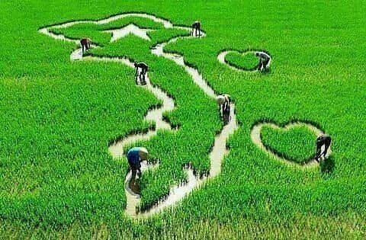
Vietnamese Orientation
VIETNAM IN YOUR NOTE
Presented by

Slide 2
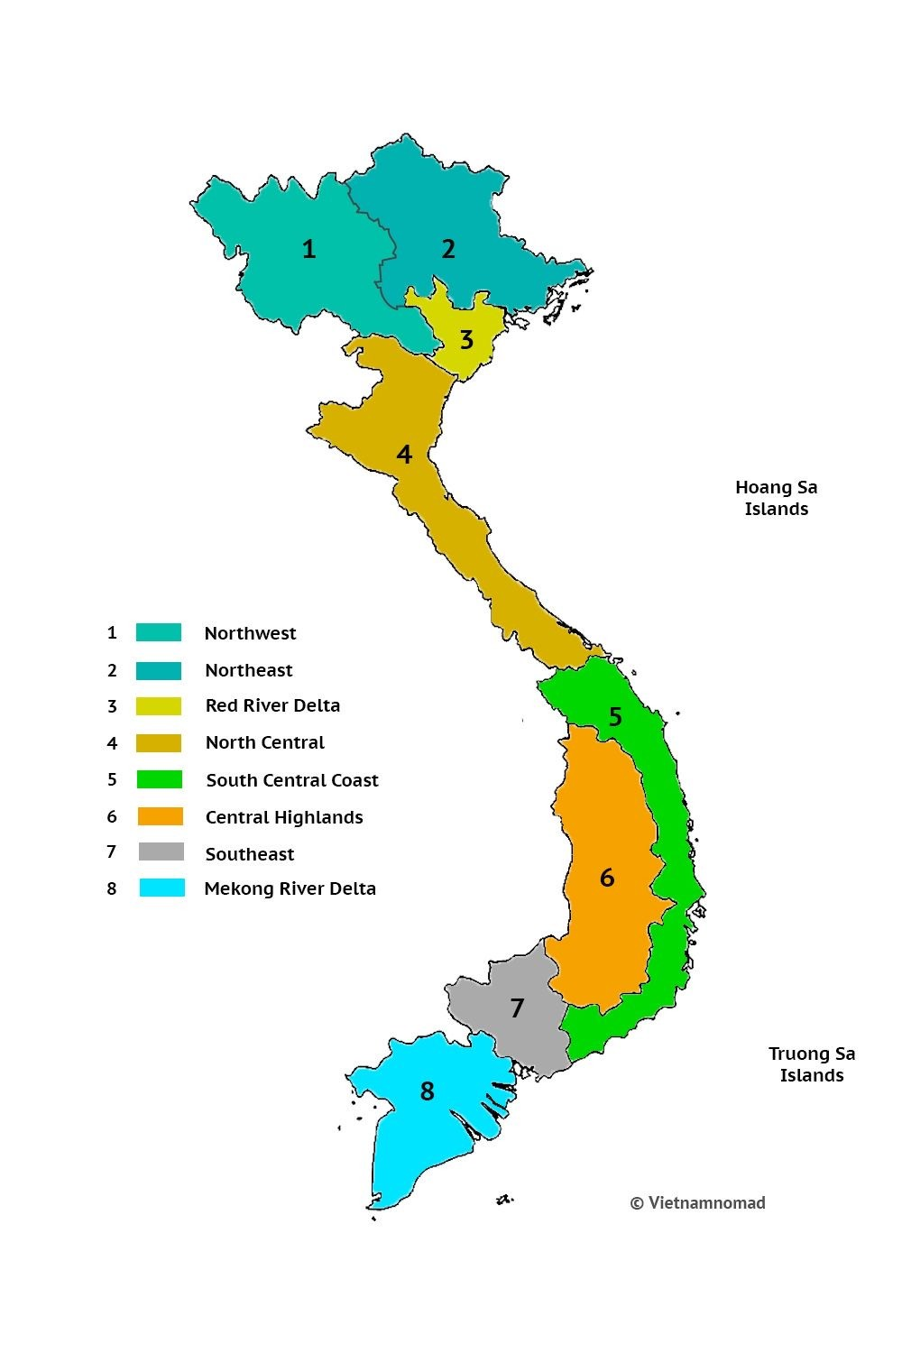

Slide 3




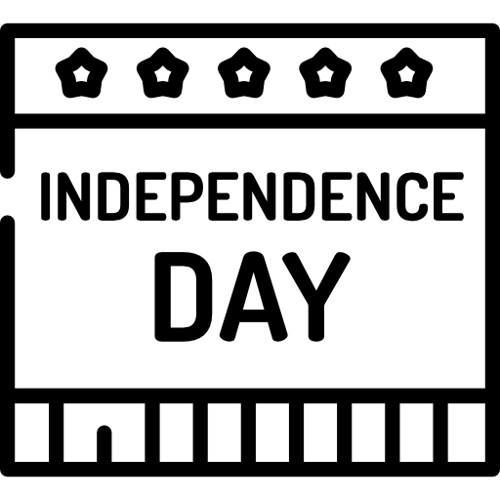
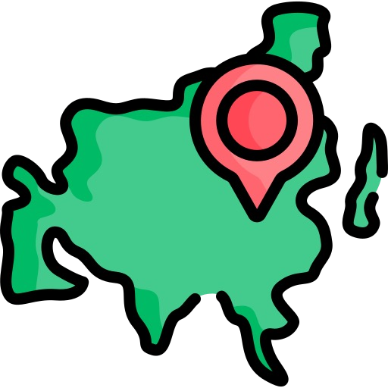


Facts about Vietnam
OFFICIAL NAME
The Socialist Republic of
Vietnam
329,560 sq. km
Hanoi
September 2nd
Vietnamese
South East Asia

Slide 4


Facts about Vietnam
Literacy rate: 95.8%
R
U
R
A
34 %
A
N
L
66 %
B
R
U
49 .8 %
Men
50. 2%
W o m e n
99.6 million
(May. 2023)

Slide 5
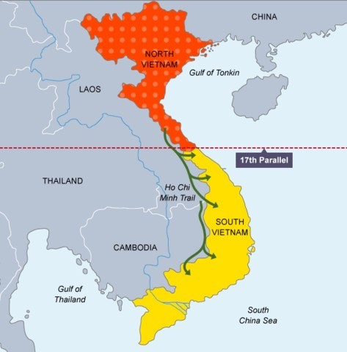





Facts about Vietnam
North & South were reunified after the Vietnam war ending in 1975
Ur
Vietnam has established diplomatic relations with 189 countries
Member of:

Slide 6


HANOI CAPITAL

Slide 7

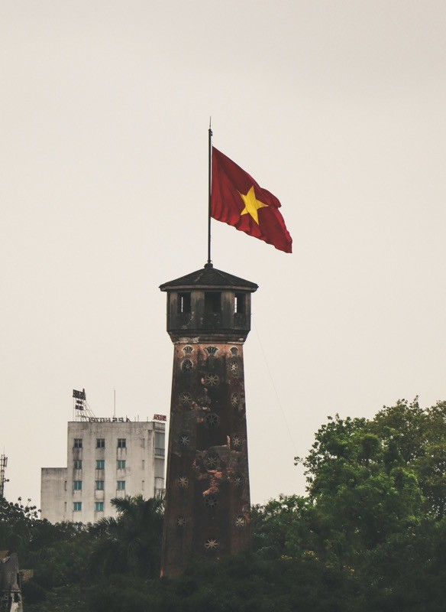
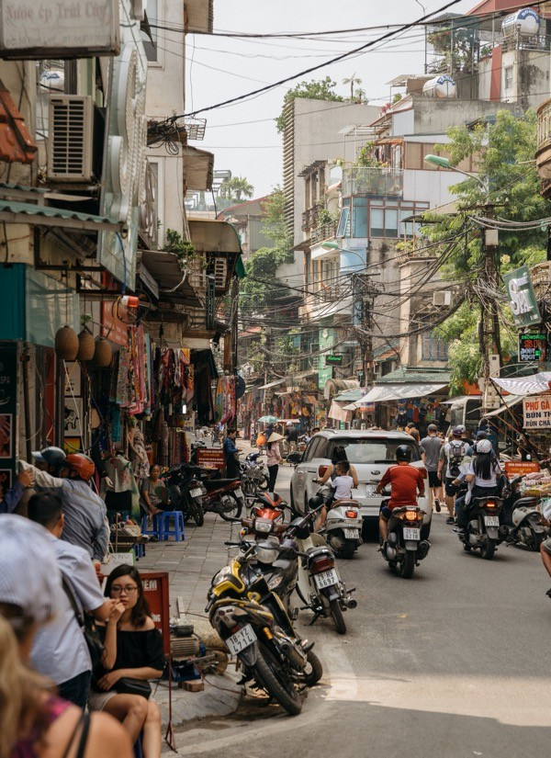

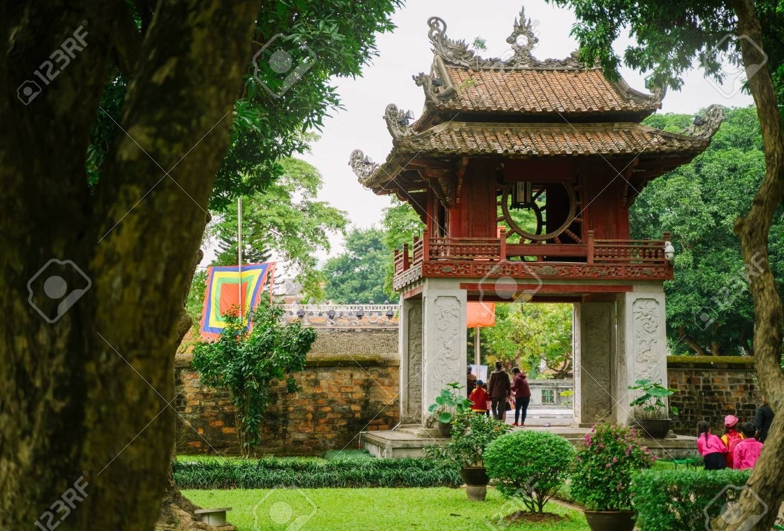
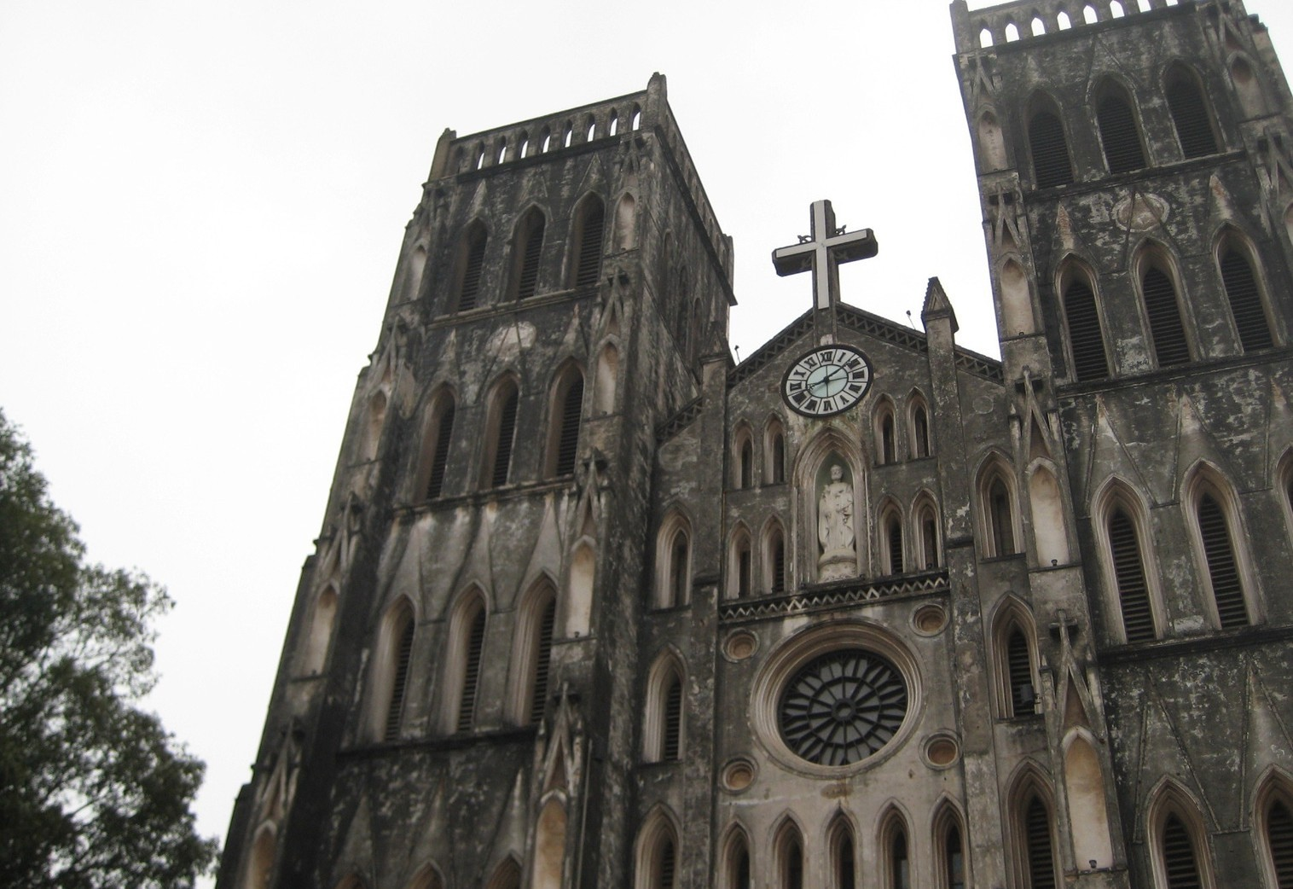
Founded in 1010
Area: 3 359 sq km
Population: 8.2 millions
Number of district: 30
Income per capita: 6 000 USD

Slide 8
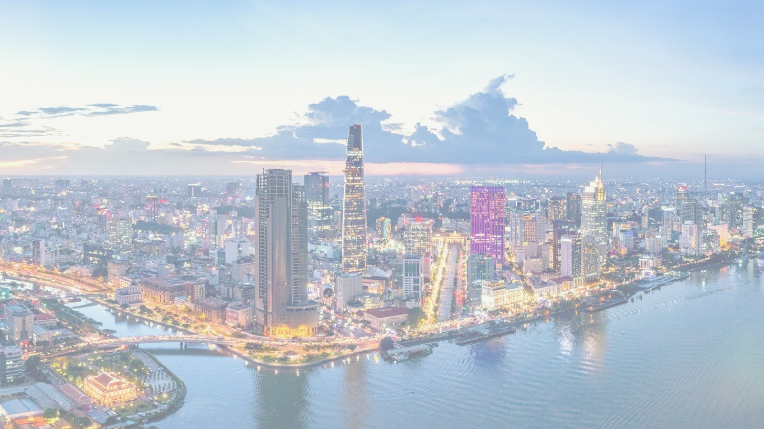

HOCHIMINH CITY

Slide 9
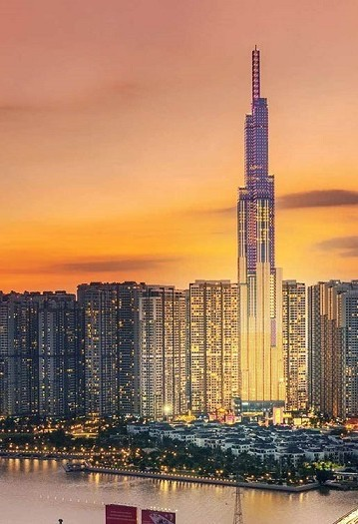
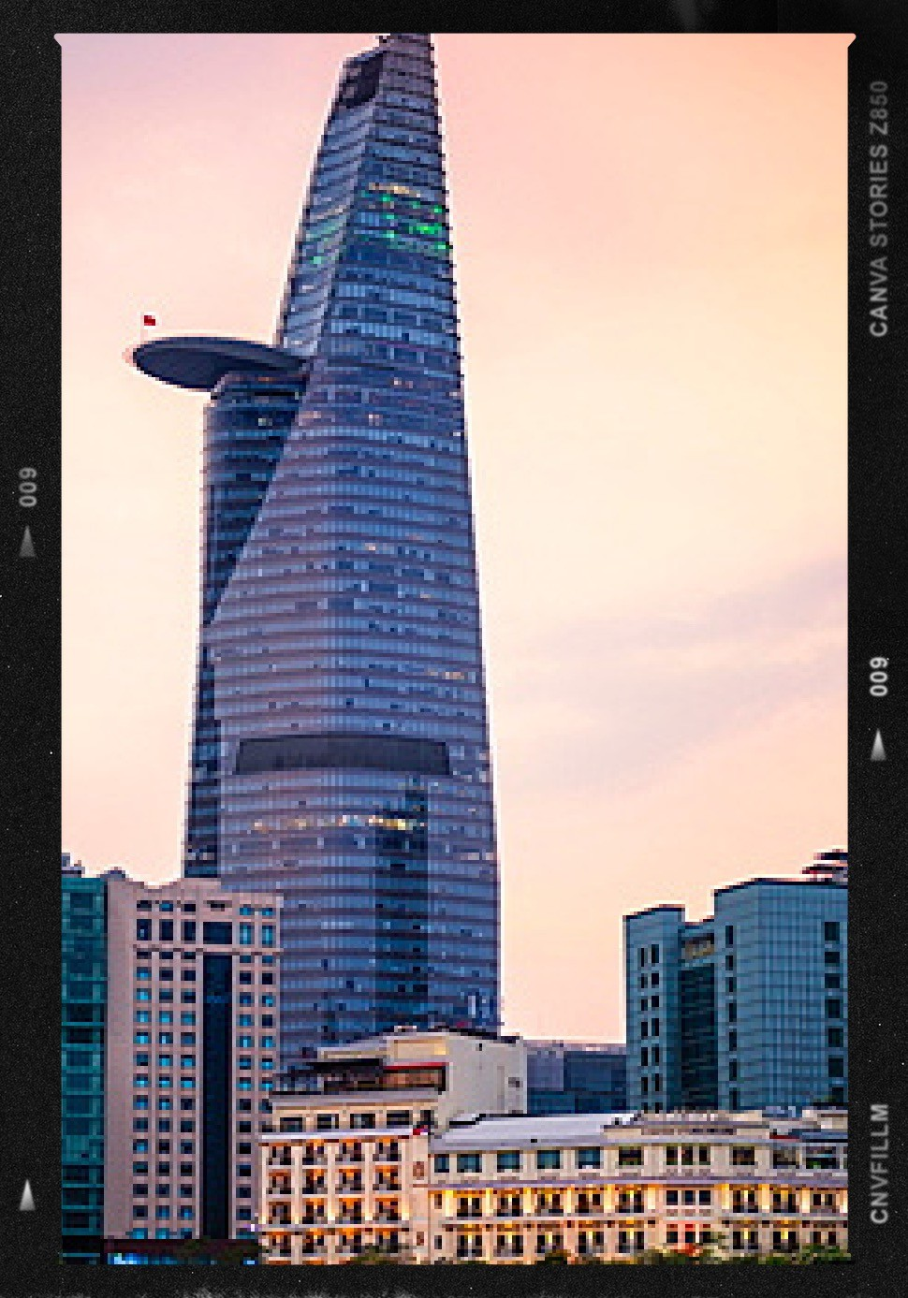
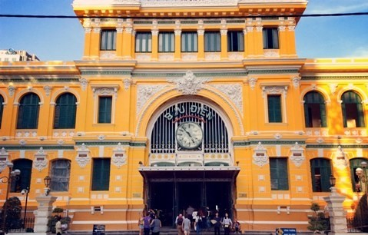
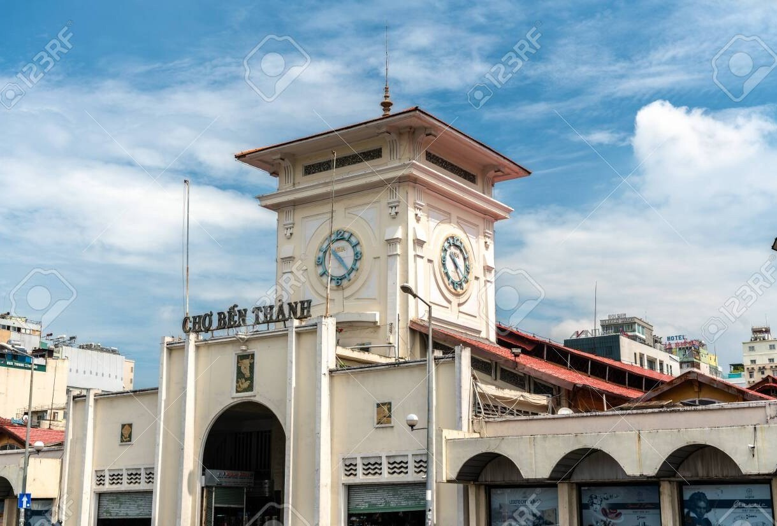
Founded in 1698
Area: 2 061 sq km
Population: 9.2 millions
Number of district: 24
Income per capita: 6 800 USD

Slide 10







Northern Vietnam
CLIMATE
Feb
Sep
May
Nov
In winter, frost and
some snow may occur on the highest mountains
for few days a year.
Tropical monsoon climate Humidity averaging 84 %
throughout the year
Tropical in south
Southern Vietnam
Temperatures range from a low of 7 °C in December and January, the coolest
months, to more than 37 °C in June and July, the
hottest months.
Mid May
Mid
May
Mid Oct

Slide 11

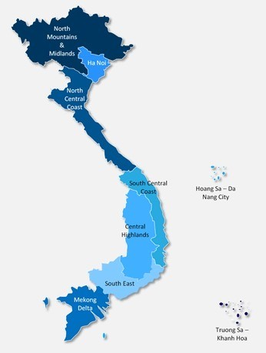



GEOGRAPHY
Phan Xi Păng is the highest mountain in Vietnam at 3,143 m.
Location
  Southeastern Asia
Bordering with China, Laos, and Cambodia
Red River Delta
North
to
Truong Son
mountain
South
distance
Area: Total: = 329,560 sq km
of
1,650
Mekong River Delta
Coastline: 3,260 km (excludes islands)
kilometers
50 kil o m e t e r s wid e at th e na r ro w e s t point

Slide 12
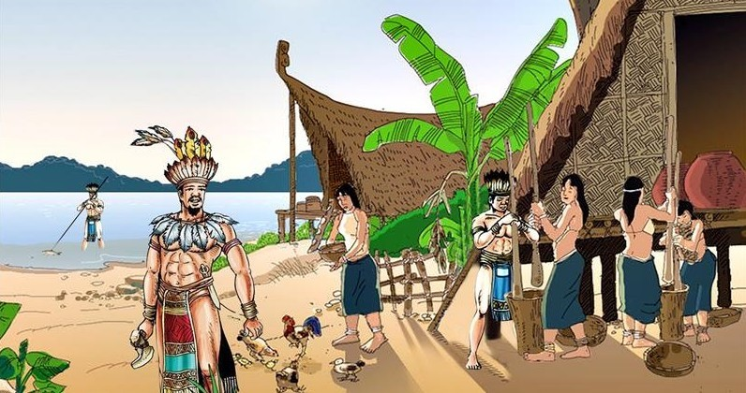
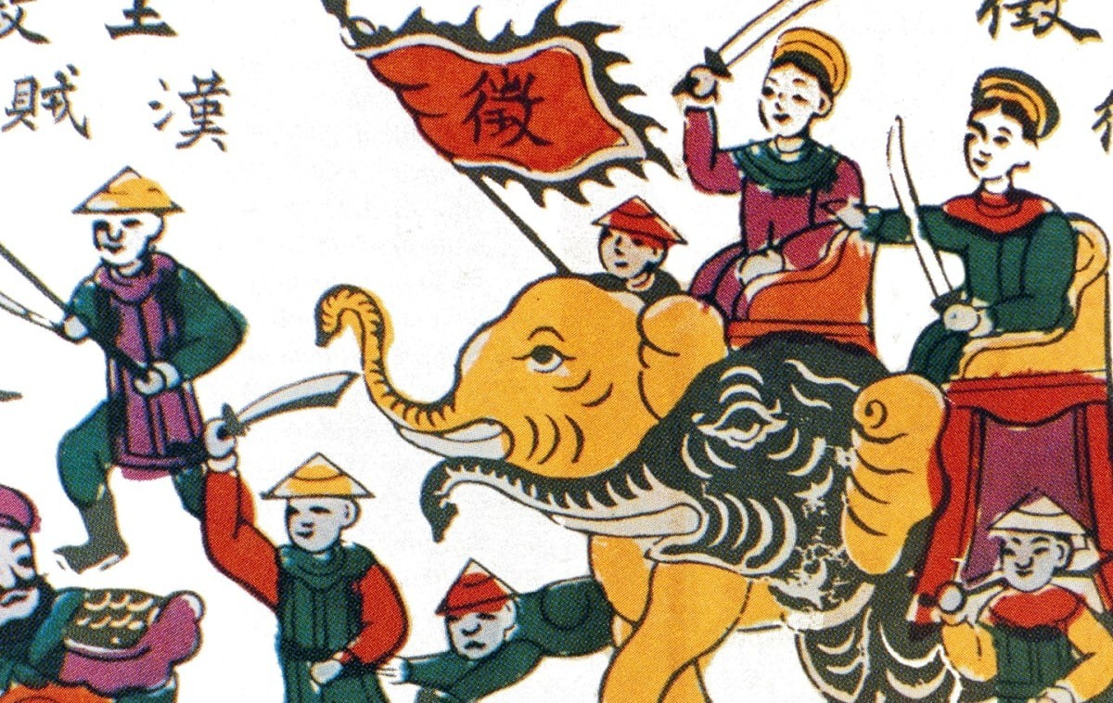
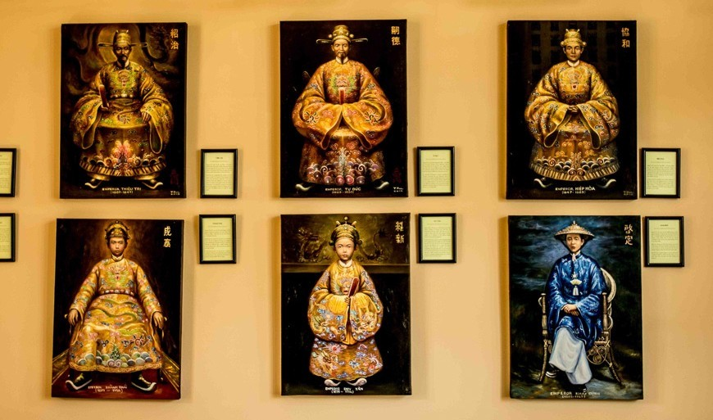
Early Kingdoms (2879 BC)
The legendary Hồng Bàng Dynasty of the Hùng Kings is considered as the first Vietnamese state.
Y
R
O
T
Period of Chinese domination (111 BC – 938 AD & 1407 - 1427).
S
I
H
Early Independence (938 AD) 7 Dynasties

Slide 13
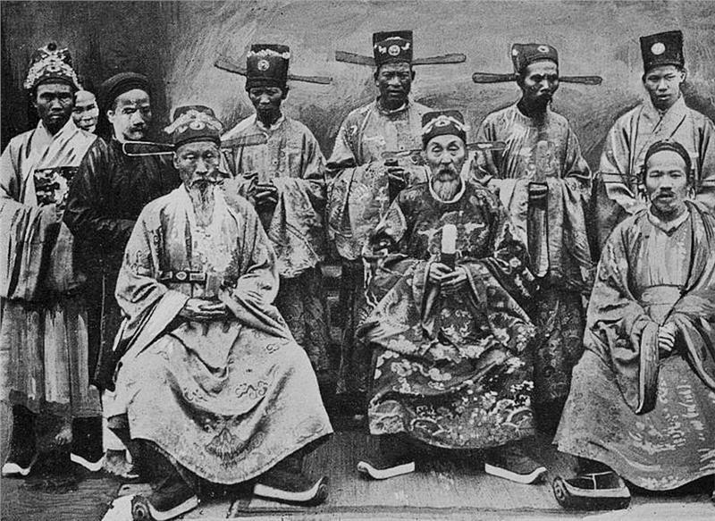
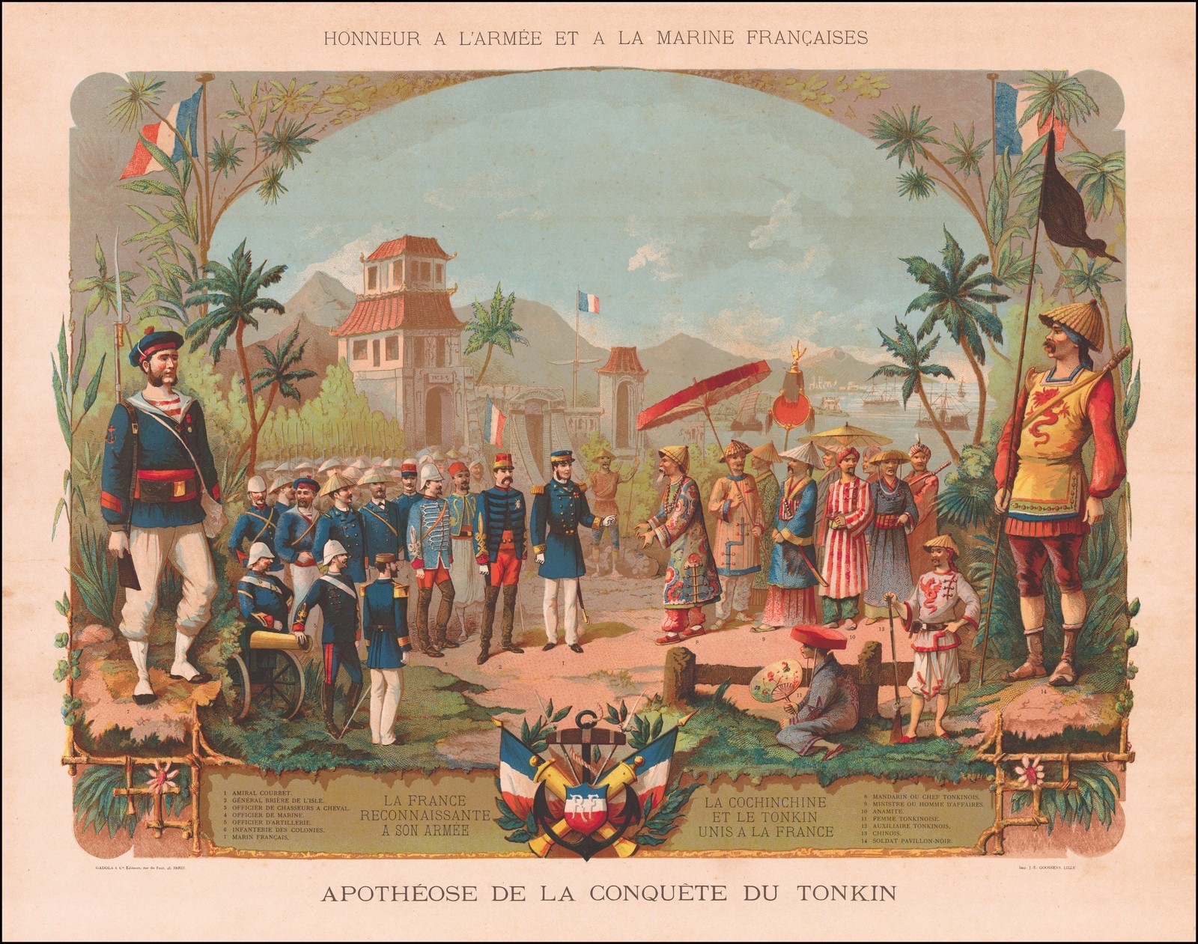
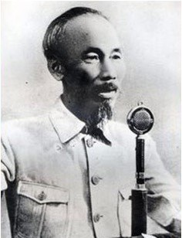
Divided Period (1528–1802) – Formation of Nguyễn Dynasty.
Y
R
O
(1858 – 1945) French colonization.
T
S
I
H
2 September 1945 : Hồ Chí Minh declared Vietnam independent.

Slide 14
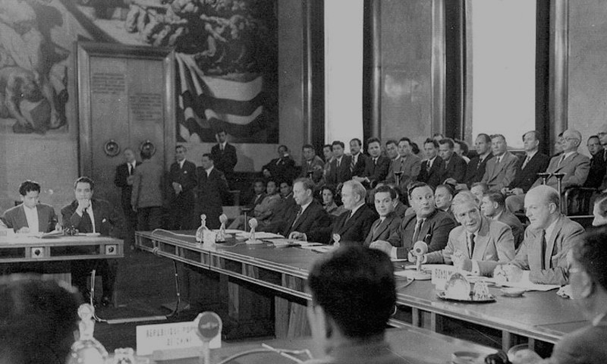
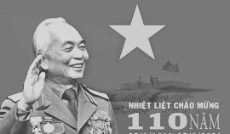
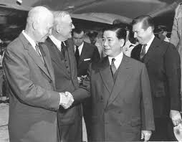
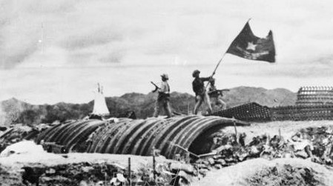
In 1954, under the General Võ Nguyên Giáp, a major battle
against French launched in Điện Biên Phủ.
Y
R
O
T
S
I
H
In July 1954, the Geneva Accord was signed between France and the Viet- Minh, paving the way for the French to leave Vietnam.

Slide 15
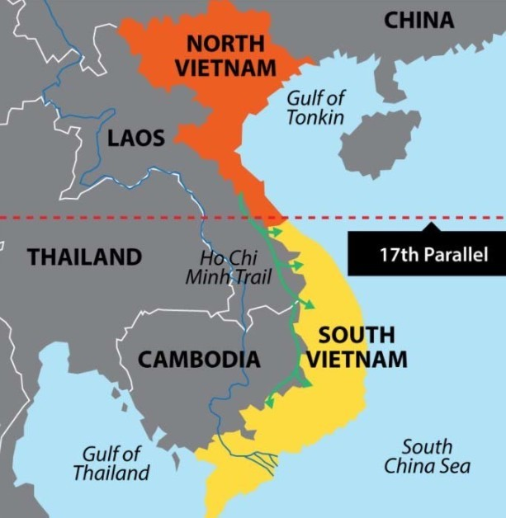
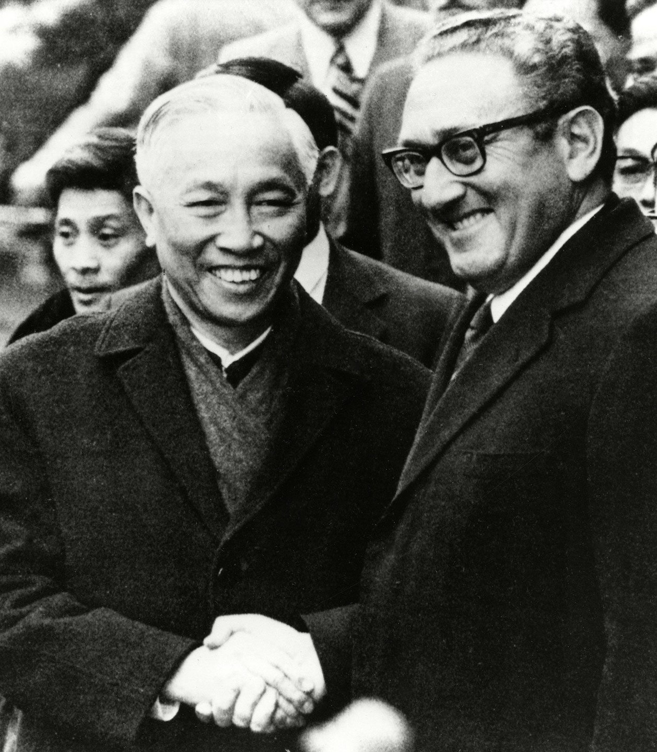
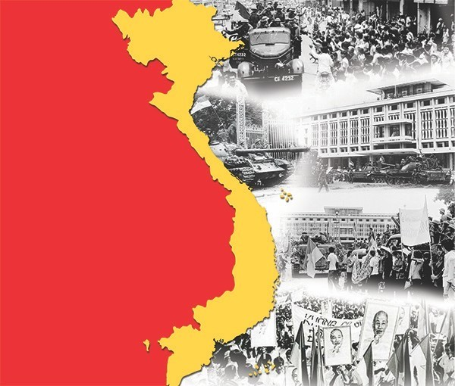
VIETNAM WAR
(1955 – 1975)
US di r e c t i n v ol v e m e n t i n Vi e t n a m Wa r (1965 – 1973)
After the Geneva
Conference Vietnam was divided into two states:
The North and the South at
the 17th parallel of latitude
In 1973, the Paris Peace Agreement was signed, American military forces to withdraw from
Vietnam.
On April 30, 1975,
Vietnam war is ended and Vietnam became
united country.

Slide 16
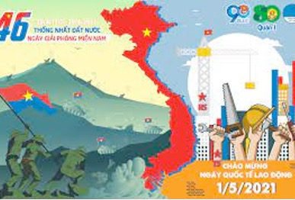
Socialism after 1975
Over 48 years Vietnam has
recovered from the ravages of war.
The economy of Vietnam has achieved rapid growth in agricultural and
industrial production, exports and foreign investment.
Since 1986, Vietnam
implemented free-market
and open for foreign investment.

Slide 17
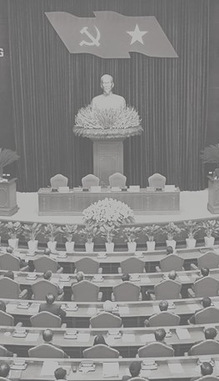
Vietnam is under the leadership of the Communist Party
National Congress takes place every 5 years to outline and formalize the country’s policies
National Assembly elects the President of the state and the
Prime Minister
G O V E R N M E N
T
The President nominates the Chief Justice of Supreme Court
& Procurator General
The Prime Minister is charged of day-to-day handling of the
Government and has the right to nominate/dismiss the members of his cabinet with the approval of the National Assembly

Slide 18
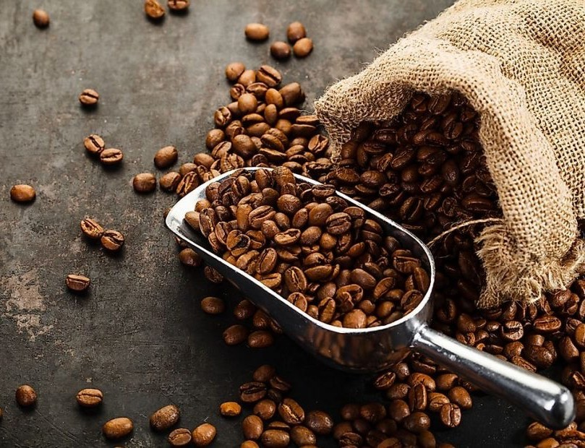
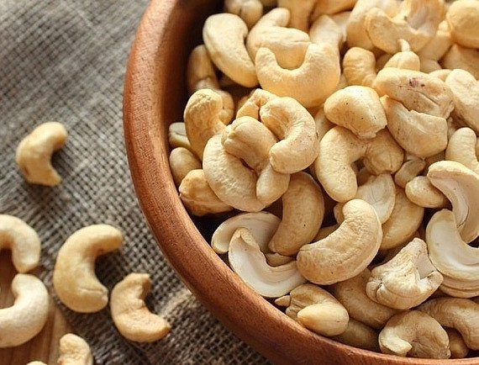

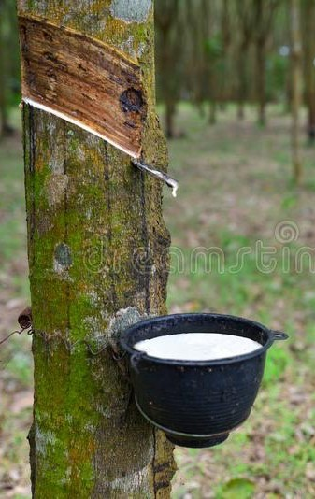
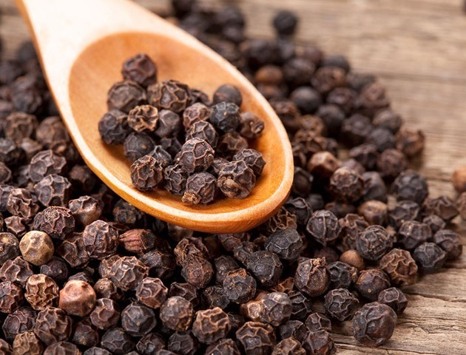
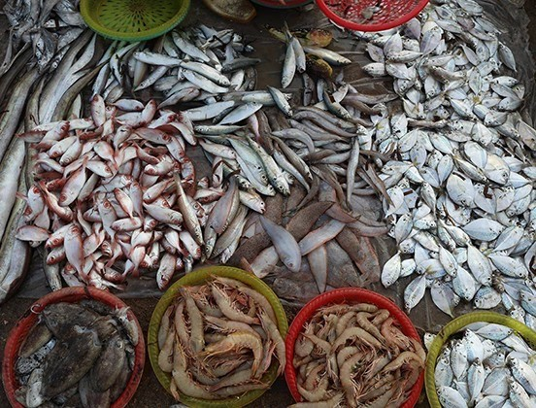
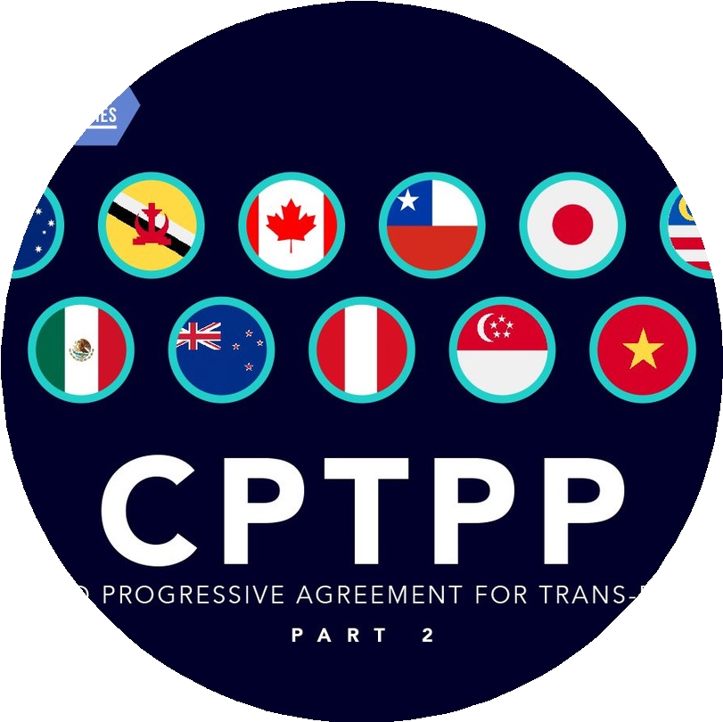

E CO N O M Y
Large exporter of :
Historically, agriculture based on wet rice cultivating
GDP: 6.5% - 8%
in recent years
Comprehensive and Progressive Agreement for Trans
Pacific Partnership (CPTPP) in Jan 2019
EU-Vietnam FTA in Aug. 2021
WTO member since 2007

Slide 19


VIETNAM IN NUMBERS
Vietnam’s poverty rate 9.35% in 2020 dropped from 25% in
2005 thanks to the national program for socio- economic development.
Life expectancy: 73.6 years
Monetary unit: Dong (X rate : 1 eur appx. = 25 . 500 vnd)
GDP: USD 409 billion (2022)
GDP per capita: USD 4,110 (2022)
GDP real growth rate: 8% (2022)
Agriculture
8 . 7 %
Export 372 billion USD (2022)
Import 359 billion USD (2022)
42 . 7 %
Service
48. 6%
Labour Force: 51 million (2022)- Une mpl o y me nt :
2. 2 %
Industry & Construction

Slide 20






MEDIA
The Media of Vietnam are tightly regulated by the
government, which views the media as "the voice of the party and of the masses" and sees its main function as
being "to propagate the party's lines and policies". First and
foremost, the media are a tool for government information and communication.
Nevertheless market
competition has caused the
Vietnamese media to embrace popular culture,
newspapers, radio, television and Internet.
Newspaper in English
Newspaper in French
Popular online newspapers in both Vietnamese & English:
vietnamnet.vn
vnexpress.vn tuoitrenew.vn

Slide 21

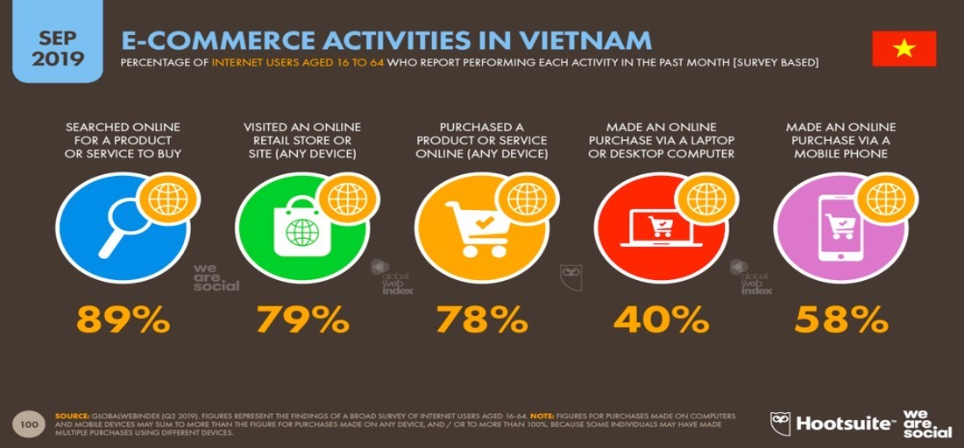
e-commerce
INTERNET &
COMMUNICATION
59
million
Internet users in Vietnam
78
million
Internet users in
Vietnam in January 2023
Vietnamese internet users aged between 16 and 64
already shop online
78%
95 %
Facebook users in
Vietnam in January 2023
156
million
Mobile connections in Vietnam in January
2022

Slide 22
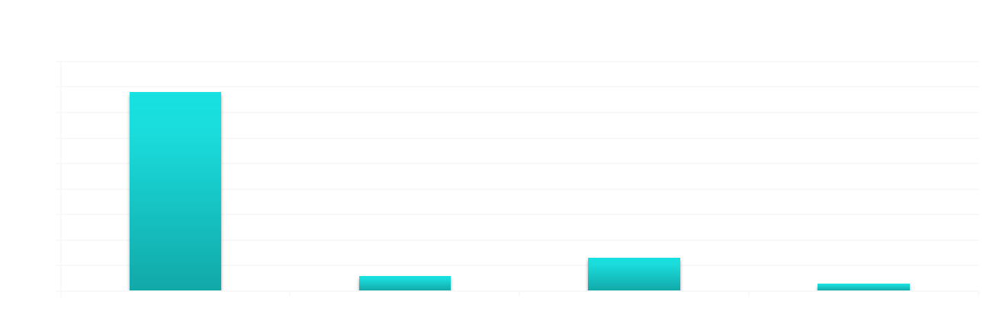
TOURISM
2741
National monuments
Vietnam Tourism accounts for 7.8% of GDP
5
6
World cultural heritage
18 million international visited Vietnam in
increased by 16% from
guests 2019,
2018
World Biosphere Reserve in Vietnam

Slide 23

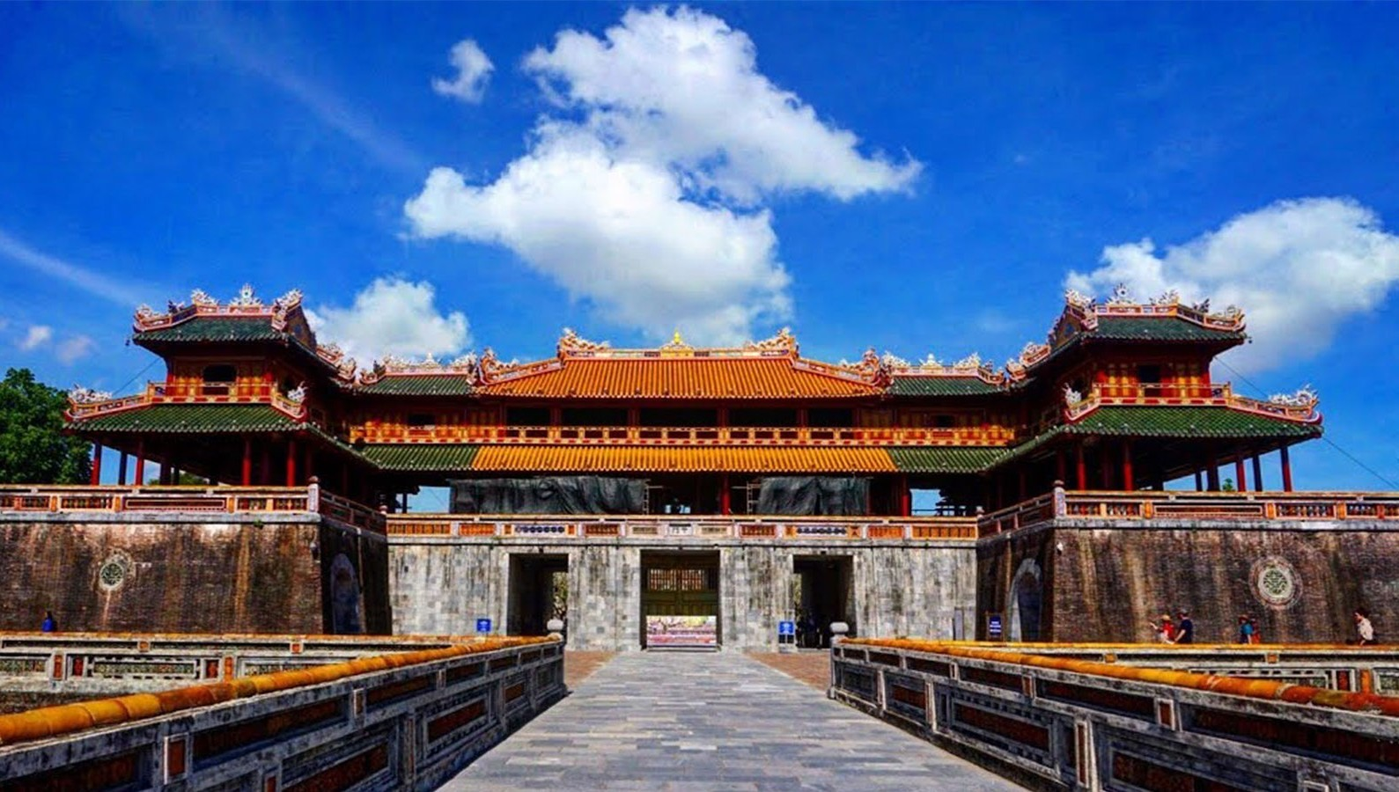
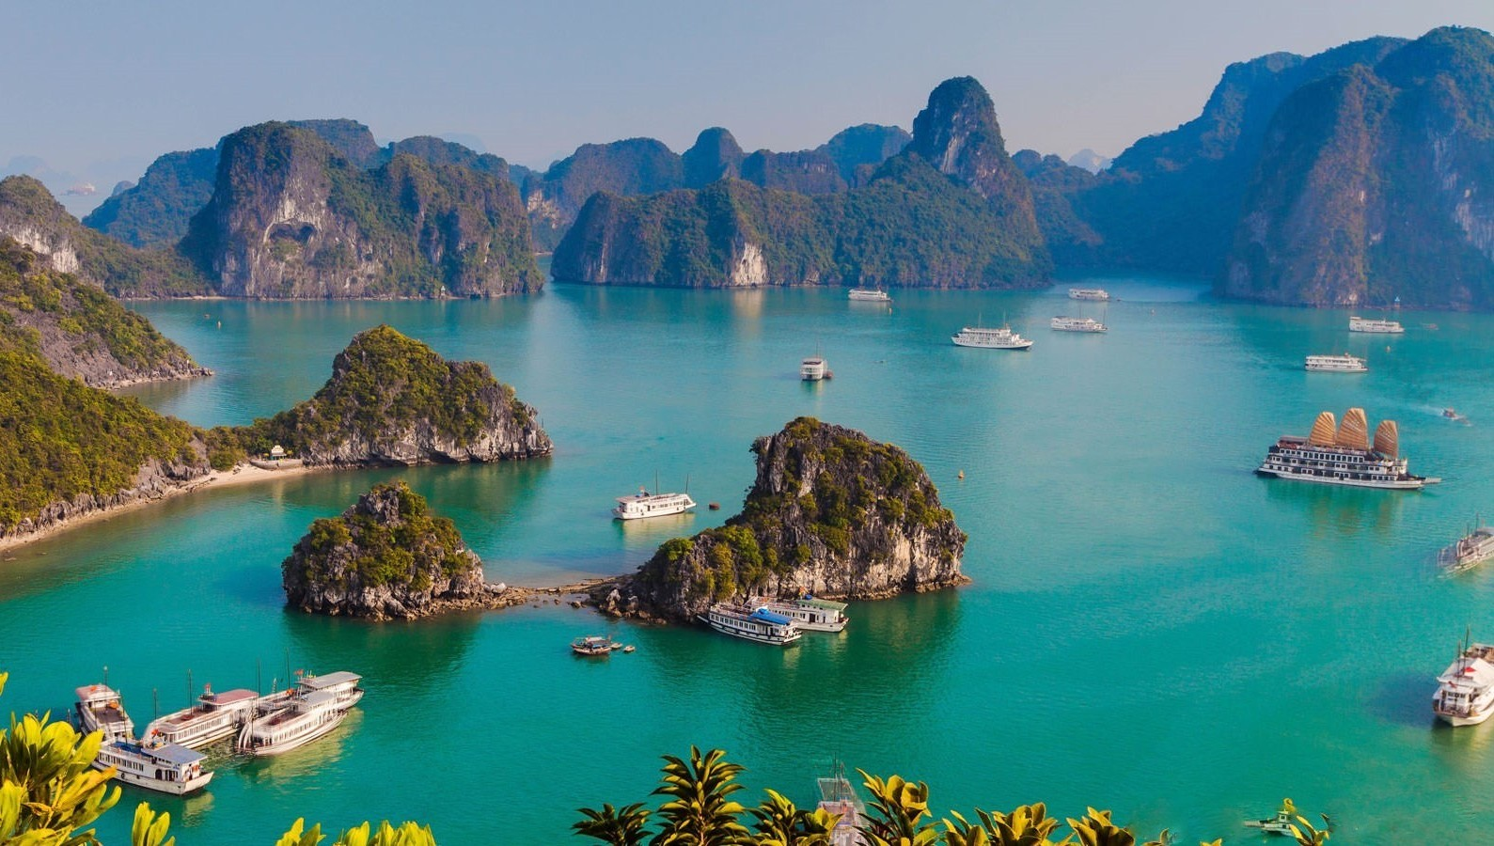
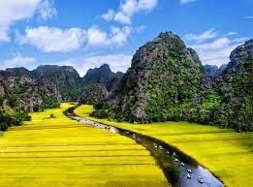
WORLD HERITAGE SITES
Central Sector of the Imperial Citadel of Thang Long – Hanoi (2010)
Citadel of the Ho Dynasty (2011)
Complex of Hue Monuments (1993) Hoi An Ancient Town (1999)
My Son Sanctuary (1999)
Cultural
Ha Long Bay (1994, 2000)
Phong Nha - Ke Bang National
Park (2003, 2015)
Natural
Mixed
Trang An Landscape Complex (2014)

Slide 24

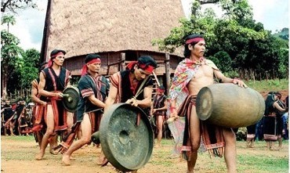
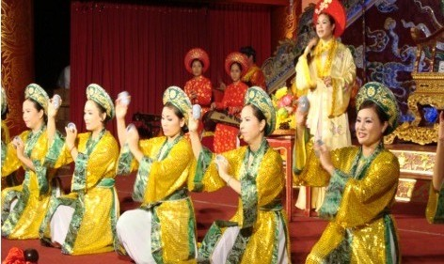

MUSIC
Vietnam has over 50 national music instruments
Vietnamese music varies slightly in the three regions: North, Central, and South.
Northern classical music is Vietnam's oldest and is traditionally more formal
Central classical music shows the influences of Champa culture
Southern music exudes a lively attitude
Intangible heritage of Vietnam to be recognized by
Gong Culture
Hue Royal Court Music

Slide 25

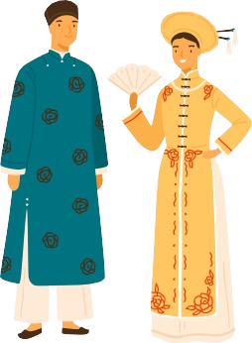
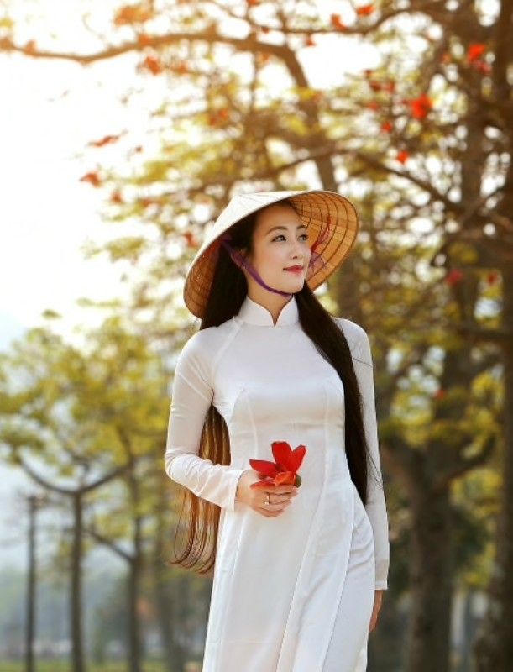
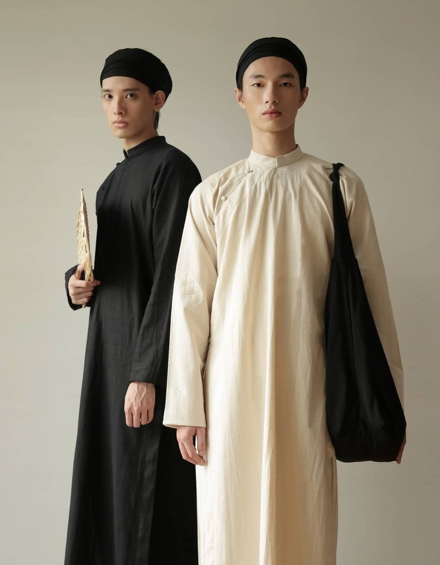
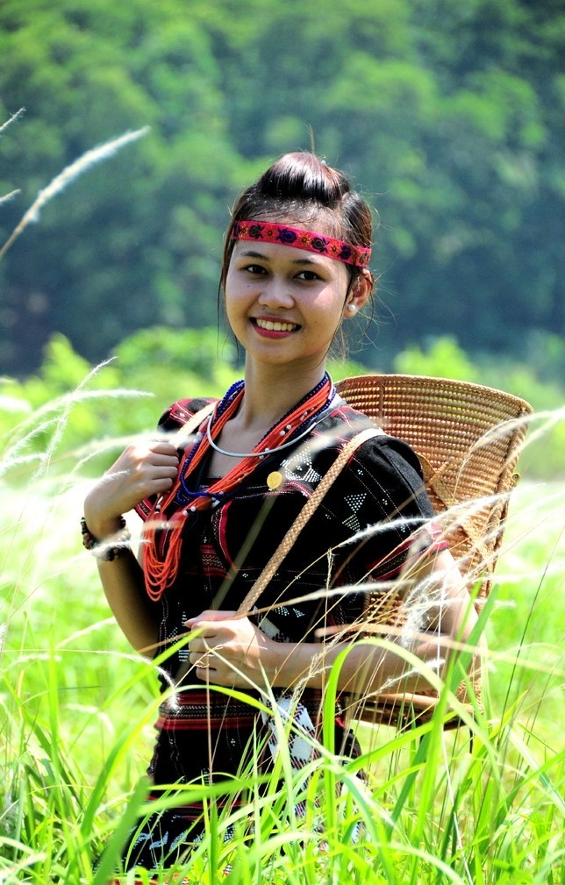
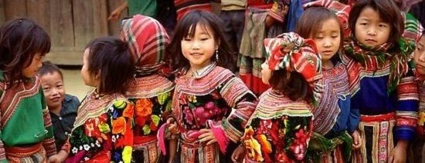
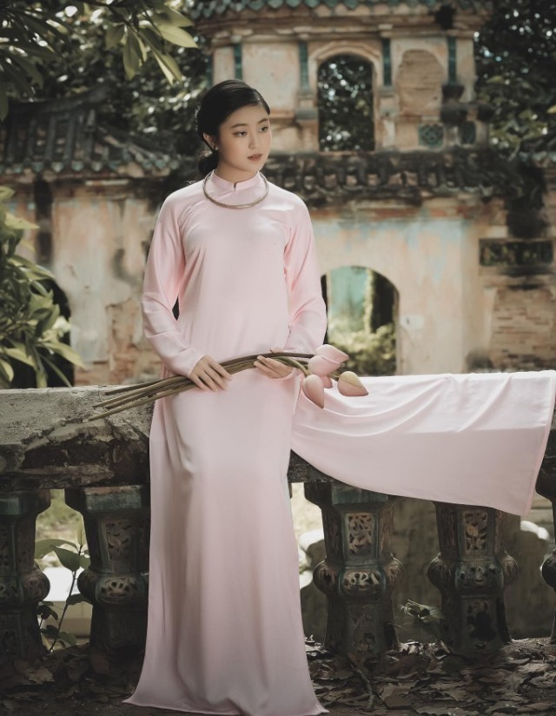
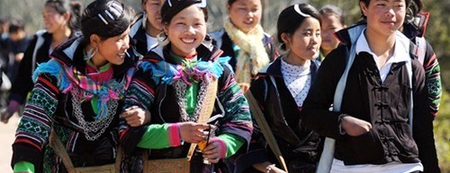
DRESS
One of the most popular Vietnamese traditional garments is the "Á o Dài", worn often for special occasions such as weddings or festivals.
40 ethnics group of the country have special traditional suits with many kinds of material.
We also have traditional suits for men and women in 3 areas : The North, the Central and the South of Vietnam.

Slide 26








GASTRONOMY
Vietnamese cuisine uses little oil and many vegetables. The
main dishes are often based on rice, soy sauce, and fish sauce.
Its characteristic flavors are sweet (sugar), spicy (peppers), sour (lime), salt (nuoc mam -fish sauce).
Vietnam also has a large variety of noodles and noodle
soups. One of the nation's most famous type of noodles is phở (pronounced "fuh”).
Let’s coming to Vietnam and you will
lavish praise when you enjoy Vietnamese
food from bustling street food or high end fine dining restaurants.

Slide 27






RELIGIONS
BUDDHISM | CATHOLIC | MUSLIM | ATHEISM
4.8 % | 6.1 % | 0.1 % | 86.3 %
The majority of Vietnamese people follow the mixture of Buddhism, Confucianism and Taoism which deeply influenced their behavior and communication.
They practice Ancestor Worship as a philosophy rather than a religion.

Slide 28













Ancestor Worship
Introduced into Vietnam by the Chinese since year 111 B.C
How do Vietnamese people worship their ancestors?
Small altar used to commune with ancestors. Incense sticks are burned frequently.
Offerings: fruits, sweet, ‘ghost money”,
replicas of motorbikes, cars, houses and so on. After worship, the paper gifts are burnt:
the spirits of the gifts can ascend to heaven
for the ancestors to use.

Slide 29


Ancestor
Why do Vie^{W}tnºam^{r}e^{s}se^{h}p^{i}e^{p}ople worship their ancestors ?
The Vietnamese accept as a fact that their ancestors continue to live in another realm. The duty of the living to meet their needs. In return, the ancestors give advice & bring good fortune.
When do Vietnamese people worship their ancestors ?
On festivals, new and full- moon days, the death day of the ancestors.
On important occasions: moving house, starting a
new business, the birth of a child.

Slide 30



Funeral
Ceremonies
Funeral ceremonies must be solemnly organized
After 49 days, the family stops bringing
for the dead to the altar.
rice
After 100 days, the family commemorates the end of the tears.
After one year there is a ceremony for the first anniversary
After two years in the end of mourning practice.

Slide 31






Contemporary Vietnamese Traditional Weddings
The wedding ceremony begins in front of the altar with the bride and the groom.
The Master of Ceremonies then
pronounce the couple starting a new
family and their parents give blessings to them.
The groom, bride, and their parents
visit each table to thank their guests.
After the banquet, the groom’s party and the bride leave for the groom’s house,
where she will live.

Slide 32




Vietnamese New Year Customs
TẾT is the most celebrated holiday in Vietnam.
The preparations are meticulous and require a lot of time in advance:
Clean and decorate the house Getting new clothes
Farewell ceremony for the Kitchen God (Ong Tao)
New Year's Eve (Giao Thua)
Giving lucky money in red envelope (Li xi)
A plate filled with five types of fruits sits on the ancestor’s altar. The fruits are colorful and meaningful.

Slide 33








Interesting differences between the Western & Vietnamese cultures
ExpressionPersonalOpinion
Get straight to the point
Get in a zig zag way
Punctuality
On time
Elastic time

Slide 34






Social & Family Hierarchy
Younger is supposed to
respect the elder & shouldn’t
argue with the elder
Equality
Life of the seniors
Living together with their children and grandchildren
Living in nursing house
Self-recognized
Self-esteem
Humble

Slide 35






Decision-making
By person in-charge
By collectivity
Anniversary
Birthday
Death anniversary
Gift
Opening upon receiving
Keep & open it
later

Slide 36






Expression of Emotion
Avoid inner negative
emotions
Express emotion as it is
Queue Culture
First come first serve
Fill in wherever is an
empty space
Travelling Spirit
Discover and experience at sites
Save all the beautiful moments in photos

Slide 37






Bathing
In the morning
In the evening
Beauty Concepts
Tanning skin
Pale skin
Sunlight
Exposure
S hield

Slide 38






NATIONAL IDENTITY
Important tenet to collectivistic cultures in Vietnam. Keep societal relations in synthesis.
Harmony
The modesty is central to Vietnamese culture with self-
humbling emotion.
Respect or compliment people means giving them face.
Being criticized or
behaving inappropriate means losing face.
People speak indirectly when they disagree with
someone.
Humility/ Modesty
This is the most embedded
quality in Vietnamese culture indicating a person’s
reputation, influence, dignity and honor.
Face

Slide 39




NATIONAL IDENTITY
Vietnamese people are quite
receptive and resigned to difficult
situations as they believe the circumstances are the result of a predetermined destiny.
Resilience & Perseverance
The cohesiveness in the family is the most important aspect of life in
Vietnam.
Respect for family & Filial piety
Filial piety is one of the traditional virtue that stresses the importance of age in society
where utter respect and devotion given to the parents and elders.

Slide 40


GREETINGS -
NAMING CONVENTION
[FAMILY NAME] NGUYEN
TRAN
[middle name] Van
Thi
[given name]:
Nam (male)
Mai (female)
Vietnamese given names often have a
literal meaning that symbolizes a positive
value, attribute or characteristic that is desired for the person or have a poetic meaning representing beauty, nature, e.g.:
Lan Liên Xuân
Middle names tend to be more gender specific. The most common middle names are:
VAN
THI
M ale
Female
Orchid Lotus
Spring
Children inherit their father’s family name at birth.
Women do not change their legal names at marriage.

Slide 41

GREETINGS -
Vietnamese people generally address one another by their
given (personal) name in any casual context. This is usually accompanied by an honorific title, based on people’s gender, age and social relationship to one another.
ADDRESSING OTHERS
Address older men or an partner who is older than you as ‘Ông’ (Mister) and older women as ‘Bà’ (Madam).
In case you don’ t know the age of your partners, using impersonal structure:
Chào ông/Chào bà
Hello
Xin chào
Address non-elderly men and women as
‘Anh’ (Mister) and ‘Chị’ (Madam) respectively.
With pleasure
Rất hân hạnh
Thank you
Cám ơn
Cám ơn anh/Cám ơn chị
Good bye
Tạm biệt
People may be referred to by their full name in formal contexts. However, it is rare to address someone by their family name alone.
See you soon
Hẹn gặp lại

Slide 42




GREETINGS - BASIC PRACTICES
Address a person by their title and first name when greeting them for the first time.
Appropriate manner of greeting: gentle handshake and smile.
Some Vietnamese might use two hands to shake by resting the left hand on top of the grasp with the
other person's hand. Bowing the head while shaking hands indicates respect.
Elders should be greeted especially respectfully. If they do not extend their hand, a respectful bow should be made instead.

Slide 43



GREETINGS - BASIC PRACTICES
In countryside, it is uncommon for
Vietnamese women to shake hands with men or each other. Therefore, wait for a woman to extend her hand first when
greeting her. If not, give a brief bow or nod.
Public displays of affections are not part of traditional Vietnamese culture. People
usually only hug to greet their relatives or very close friends.
Questions about someone’s family are
appreciated during or after introductions.

Slide 44
ETIQUETTE
In Western culture, the expressions such as “thank you”, “excuse me” or “sorry” are said to acknowledge minor incidents & courtesies.
In Vietnamese culture, people tend only to apologies or thank when they truly believe that one’s actions have
indebted them or deserve gratitude.
Manners in Vietnam: underpinned by the value of modest
This cultural difference in manners
sometimes leads foreigners to perceive Vietnamese as rude or disrespectful.
E.g: They may not give a grateful response when being offered
compliments.
E.g: When you give something to someone, instead of saying
“cám ơn = thank you”, they might say “tôi xin = I beg you”.
Respect is however perceived and exhibited in different
ways in Vietnam

Slide 45




ETIQUETTE
Objects should be passed, given or received with both hands together.
Feet are thought to be the ‘dirtiest’ part of the body. The soles of one’s feet should
never be pointed at another person.
The head of a person is sacred. Don’t touch someone on the top of their head and do not pass things over another person’s head. It is rude and insensitive.
Incense is generally only lit for rituals, anniversaries, times of mourning or in temples.

Slide 46



GIFT
Local people who offer assistance appreciate small gifts: pens; liquor.
Gift are given in occasions such as birthday Women’s day; Lunar New Year. When giving a gift, the Vietnamese common belittle it as being unworthy for the receiver. A common expression is “chút quà nhỏ” – “ a humble gift”.
They may say a gift is from someone else to downplay the role they had in making the kind gesture. E.g: “my wife gave me this to offer you”.
Vietnamese people don’t commonly open the gift in front of the giver or show up their over- enthusiasm to the gift.
Do not give handkerchiefs, knives, wallet, candle and anything black as a gift. This can be interpreted as a bad omen.
Wedding/Funeral: Almost everyone gives an envelope containing substantial amount.

Slide 47







COSTUME
CLOTHING
Respect local dress standards.
Avoid wearing shorts or sleeveless tops and
sometimes remove your shoes before entering a religious place.
Nude and topless sunbathing in public is totally inappropriate.
TAKE OFF THE SHOES
Vietnamese are obsessed with clean floors and it is usual to remove shoes when entering the house.
Your host will probably provide a pair of slippers.

Slide 48





EATING
Do not pass food from chopstick to chopstick.
Do not rest your chopsticks upright in a bowl of rice as this symbolizes the burning of
incense (which is usually reserved for times of mourning).
  The person who invites other members of a
company out to a meal generally pays for the bill at a restaurant.

Slide 49





COMMUNICATIONS - VERBAL
INDIRECT COMMUNICATION
The Vietnamese are indirect verbal communicators
LANGUAGE STYLE
Rarely use colorful expressions. E.g: say “like” something instead of “love” it, they feel “bad” instead of “awful”, or that something is “good” instead of “amazing”.
PITY the UNMARRIED
Almost every Vietnamese will ask if you are married and have children. Telling
the Vietnamese that you don’t like getting married or enjoying a life
without children is weird. Not having a family means a bad luck and such people are to be pitied.
COMPLIMENT
Compliments may be received differently. Some Vietnamese may politely protest or deflect kind words in an effort to remain
humble. They may reply to a compliment by a smile or saying “vậy à = really?”.

Slide 50





COMMUNICATIONS -
REFUSALS
VERBAL
Avoid giving a flat ‘no’ or negative
response for saving face and politeness, even when they disagree with you.
AGREEMENT
A ‘yes’ may be spoken to indicate “I
listen to you” or “I understand” rather than “I agree with what is said”.
LOUD VOICES
  Speaking in a raised voice is generally seen as improper behavior.
Focus on hints of hesitation in terms of how it is said
with what body language
Find the underlying meaning by asking open-ended
questions.

Slide 51





COMMUNICATIONS - NON VERBAL
PHYSICAL CONTACT
Avoid back slapping, putting arm around someone's shoulder except between close friends.
POINTING
Avoid pointing at people/things with your index finger. Use your open hand instead.
BECKONING
To beckon, use your open hand rather than index finger.

Slide 52




COMMUNICATIONS - NON VERBAL
EYE CONTACT
It is respectful to defer eye contact away from those who are of the opposite gender, a higher status, older than you.
However, direct eye contact is held with one’s peers.
EXPRESSIONS
The Vietnamese show less emotion in their face as they communicate & often adopt a neutral expression.
ARMS
It can be considered rude to
stand with your hands on your hips or cross your arms when having a conversation.

Slide 53






COMMUNICATIONS - NON VERBAL
SILENCE
Silence is an important & purposeful tool used in the communication style of most Asian countries. Pausing before giving a response indicates that someone has applied appropriate thought and
consideration to the question. It reflects politeness and respect.
SMILING
Smiling can be used for all sort of
emotions: modestly acknowledge what
another person is saying without seeming too over-enthusiastic/ talking about
painful or awkward experiences/Non-verbally
apologizing for discomfort/when embarrassed, apologetic …
GESTURE
The symbol for ‘okay’ in Western culture is not common in Vietnam. Instead, a
thumb-up signal means OK.

Slide 54






Do
DO & DON’T
Hints
Respect when they protest politely or deflect compliments in an effort to remain humble.
Keep discussion
harmonious and balanced.
Be sensitive to Vietnam’s history.
Try not to be offended if an older person makes frank
comments or asks invasive
questions about your personal life.
How to answer indirectly the following questions:
“Are you married?”
Not yet, I am still young / I am still looking for a right person.
"W h y don’t you have kids yet?”
I need more time to well prepare for a baby
“How much do you earn?”
So so / Quite good

Slide 55



DO & DON’T
Don't
Avoid directly criticizing someone’s mistakes. This can quickly cause a Vietnamese to lose face.
Don' t assume that the Vietnamese have a natural alignment with
China.
Tr y not to interrupt or ‘fill in’ the silence if a Vietnamese person is quiet during a conversation.

Slide 56



DO & DON’T
Don't
Do not break any promises that you have already
committed to, verbally or written. This can lead to a
big loss of face and jeopardize
the trust and confidence in you.
Do not assume that a
Vietnamese person wants to talk about the Vietnam War.

Slide 57



BUSINESS CULTURE
MAKING DECISION PROCESS
Everyone is consulted before
reaching a decision, which can lead to lengthy negotiations.
When there is a point of tension or difficulty that can’t be resolved,
Vietnamese businessmen sometimes resort to sitting in silence to simmer
back to harmony so that there is a clear
space for a new topic of discussion.
To avoid the loss of face, a Vietnamese person may seek to resolve issues in the workplace indirectly. For example, they may use a third person to reject a
proposal, ask for feedback or discuss problems.
HIERARCHY CULTURE
Workplaces based on position.
Everyone has a role and distinct place within their business.

Slide 58




BUSINESS CULTURE
RELATIONSHIP ORIENTED
Personal relationships play a large role in Vietnamese business culture. Third-party introductions are a necessity. Trust is key to good business.
The business networks are often comprised of relatives and peers as nepotism guarantees
trust. They only want to expand their
networks with partners they can rely on.
All disagreements or conflicts should be dealt with in the most diplomatic manner possible.
Don’t display anger or lose your temper, they’ll lose their trust in doing business with you.
In your offer/contract, please do it as detailed as possible.

Slide 59


BUSINESS CULTURE
Receiving Business Cards: Use both hands or the right hand to receive a business card. Regard it carefully and place it in front of you on the table until everyone is seated.
Presenting Business Cards: Use both hands or the right hand when presenting business card.
Make sure the writing is facing the other person.
MEETINGS
Be punctual.
Vietnamese generally enters a
meeting with the highest ranking person arriving first and so on.
The same goes for introductions.
Y o u a r e e x p e c t e d t o g r ee t everyone in the room individually, even if the group is large.
Vietnamese people will be interested to know your age so they can address you properly.
A llow a few moments of social conversation to pass before mentioning business.
Negotiate in a firm and fair, diplomatic manner.

Slide 60







THANK YOU FOR YOUR ATTENTION !
THANK ALL RESEARCHERS FOR YOUR CLOSE COOPERATION AND SUPPORT !
.
https://vn-eu-tradehub.com/
BE@moit.gov.vn
Viet-Nam-Trade-Office-to-Belgium-EU-
and-Luxembourg
@ Vietnam Eu

