Slide 1


Why Vietnam: a Destination for your business success?
6th Edition

Slide 2

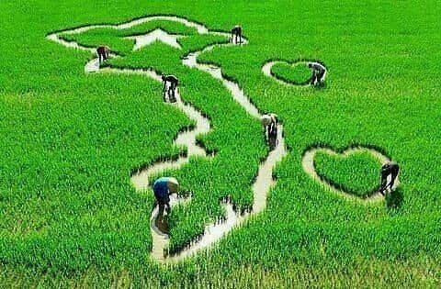
WHY VIETNAM ?
Viet Nam in the trend of global supply chain and production value chain shifts

Slide 3

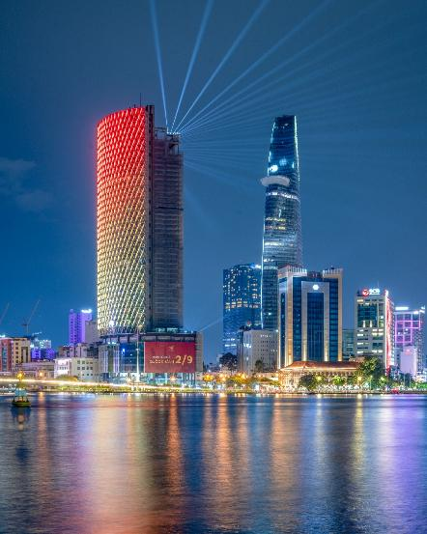
Nation | The Socialist Republic of Viet Nam
Area | 331.230 km² North-South distance: 1,650 km; Coastline length: 3,200 km
Climate | Southern Viet Nam: Tropical monsoon climate - rainy and dry seasons Northern Viet Nam: Subtropical climate with four seasons
Population | 102.300.267 people Ethnicity: Kinh: 85.3%
Language | Vietnamese
Political system | Socialist-oriented market economy system Communist Party: The only organization that leads the state
THÔNG TIN CHUNG VỀ VIỆT NAM

Slide 4
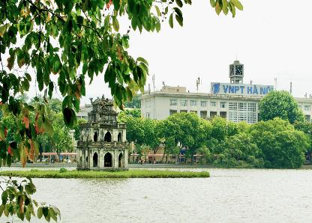
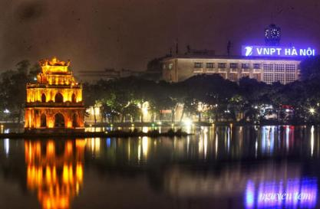
1
Economy of Viet Nam

Slide 5
Economy of Viet Nam
Focus on continued growth driven by foreign direct investment (FDI) and foreign trade
FDI inflows into Viet Nam in 2025 reached USD 38.42 billion, with cumulative inflows totaling USD 529.6 billion.
The Government’s target for 2025 is GDP growth of 10%, while neighboring countries are expected to grow at around 3–7%.
Stable macroeconomic conditions
High growth rate
GDP growth in 2025 reached 8.02%.
CPI increased by 3.31%, while core inflation rose by 3.21% compared to 2024.
Overall macroeconomic indicators remained stable.
Key economic indicators of Viet Nam
Chỉ số chính | 2016 | 2017 | 2018 | 2019 | 2020 | 2021 | 2022 | 2023 | 2024 | 2025
GDP (USD billion) | 201 | 223 | 242 | 266 | 271 | 366 | 416 | 430 | 476 | 514
GDP growth (%) | 6,2 | 6,81 | 7,08 | 7,02 | 2,91 | 2,58 | 8,02 | 5,05 | 7,09 | 8,02
GDP per capita (USD) | 2.172 | 2.385 | 2.587 | 2.800 | 2.779 | 3.700 | 4.162 | 4.284 | 4.700 | 5.026
Urban unemployment rate (%) | 3,23 | 3,18 | 2,95 | 2,93 | 3,61 | 4,42 | 1,70 | 2,43 | 2,53 | 2,51
Average annual inflation rate (%) | 2,67 | 3,53 | 3,54 | 2,79 | 2,31 | 2,33 | 3,21 | 3,06 | 3,34 | 3,31
Exchange rate (VND/USD) | 21.935 | 22.242 | 22.730 | 23.173 | 23.155 | 22.839 | 22.920 | 23.627 | 25.488 | 26.300
Source: International Monetary Fund (IMF), General Statistics Office of Viet Nam (GSO)

Slide 6
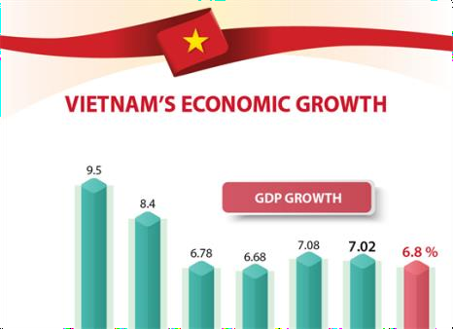
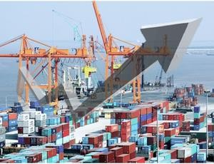
FTA in which Vietnam has joined cover most continents.
COUPLED WITH WTO ACCESSION IN 2007, IMPLEMENTATION OF FTAs CONTRIBUTE TO BOOSTING
GDP up by >663% | Export value up 969%

Slide 7
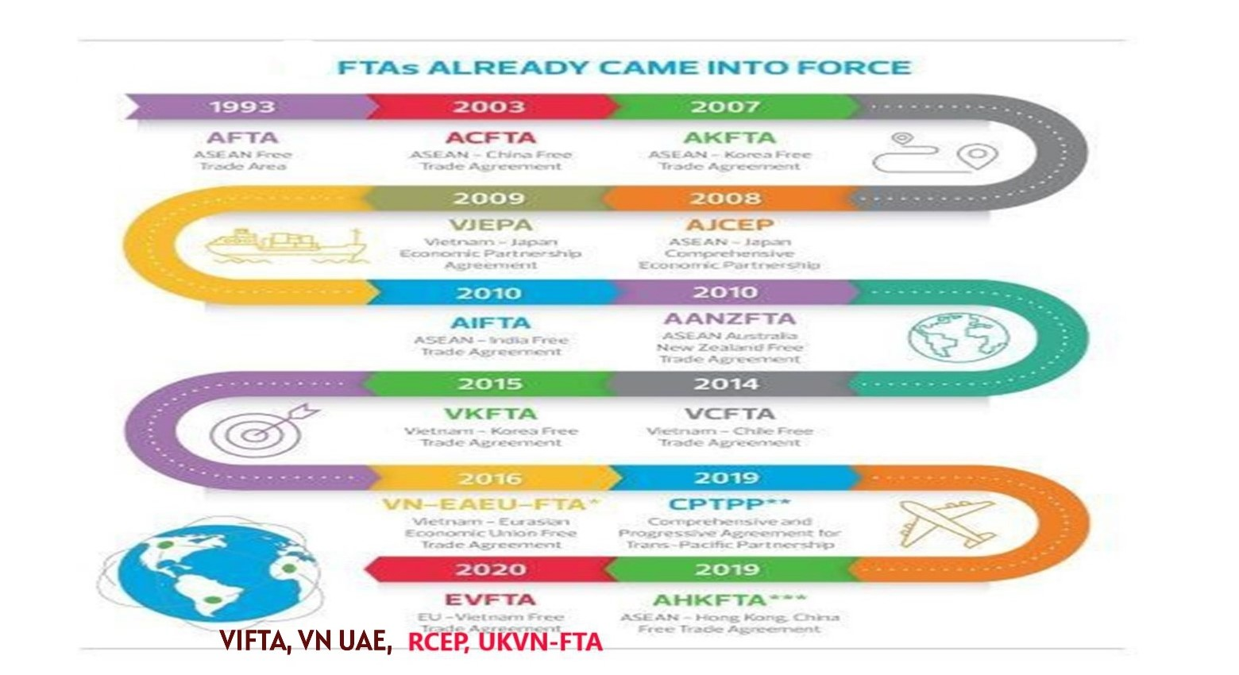
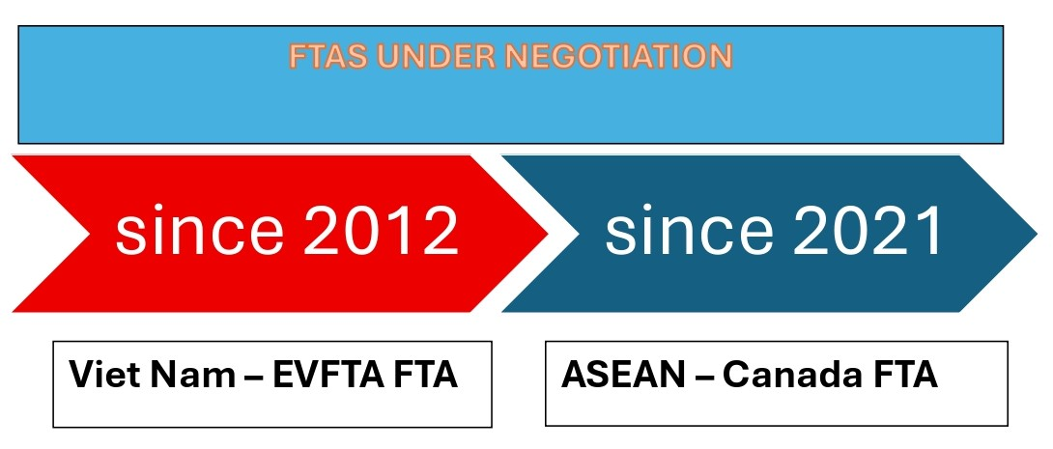

Slide 8
GRDP of Localities in 2025
Gross Regional Domestic Product (GRDP) – Million USD

Slide 9

Viet Nam’s Import and Export in 2025
EXPORTS
470 billion USD
15,9%
IMPORTS
449 billion USD
18%
Economic growth
7,09 % (2024) 8,02 % (2025)
Source: National Statistics Office (NSO) of Viet Nam

Slide 10




FDI 2025
18/21 SECTORS
Japan
(USD 3.7 billion)
Singapore
(USD 9.4 billion)
Korea
(USD 5.2 billiom)
China
(USD 5.7 billion)
Source: National Statistics Office (NSO) of Viet Nam
Notes:
Lũy kế đến hết tháng 12 năm 2023, 144 quốc gia, vùng lãnh thổ có đầu tư tại Việt Nam với 39.140 dự án, tổng vốn đăng ký 468,9 tỷ USD
Các ngành thu hút vốn đầu tư nhiều nhất gồm: công nghiệp, chế biến chế tạo (chiếm 64,2% vốn đầu tư), tiếp theo là bất động sản; sản xuất, phân phối điện; tài chính ngân hàng và các ngành khác
Tổng vốn đầu tư nước ngoài đăng ký vào Việt Nam năm 2023 đạt hơn 36,6 tỷ USD;
Hơn 3.188 dự án FDI đăng ký đầu tư mới, tổng vốn đăng ký mới 20,19 tỷ USD; Số dự án tăng 56,6% và gần 62% về số vốn;
Ngành công nghiệp chế biến chế tạo dẫn đầu với tổng vốn đầu tư đạt hơn 23,5 tỷ USD, chiếm hơn 64,2% tổng vốn đầu tư đăng ký và tăng 39,9% so với cùng kỳ.

Slide 11
By December 31, 2025, there were 153 countries and territories investing in Viet Nam, with 45,416 projects and total registered capital of USD 529.6 billion.
Source: National Statistics Office (NSO) of Viet Nam

Slide 12
Shifts in Viet Nam’s GDP and FDI
Along with FDI growth, Viet Nam has achieved strong economic growth.
In the upcoming period, “quality” will be the key factor for FDI.
Comprehensive and Progressive Trans-Pacific Partnership Agreement (CPTPP)
Covid-19
Pandemic
Announcement of the 5-Year Socio-Economic Development Plan (2016-2020)
Enact the Investment Law and the Enterprise Law
Announcement of the 10-year socio-economic development strategy (2011-2020)
Viet Nam-Japan Economic Partnership Agreement
(Viet Nam's first bilateral EPA)
Viet Nam joins
the WTO
Signing of the
Viet Nam - Japan Investment Agreement
Implement the unified Investment Law/Enterprise Law
Amended Foreign Investment Law

Slide 13
Viet Nam’s Economic Strategic Targets
2026
GDP growth ≥ 10%
GDP per capita 5,400 - 5,500 USD
Process of manufacturing industry: Approximately 24.96% of GDP
CPI (Inflation) increase rate: Approximately 4.5%
Labor productivity increase rate: Approximately 8.5%
2026 - 2030
Average GDP growth: Reaching 10% or more per year (Double-digit growth target)
GDP per capita: Approximately US$8,500 by 2030
Striving to place Viet Nam among the top 30 largest economies in the world by GDP size.
Manufacturing industry share: Approximately 28% of GDP.
Digital economy: Approximately 30% of GDP.
Contribution of total factor productivity (TFP) to growth: Over 55%.
Investment: Total social investment capital over the next 5 years will reach approximately 40% of GDP.

Slide 14
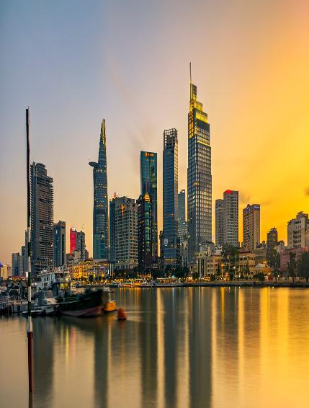
2
Attracting foreign investment in
Viet Nam

Slide 15

Net Zero
Government Commitments and Goals
0
43,5%
Emission reduction by 2030
2028
PLANS
Net emissions in 2050
Carbon market operation
Income
Resolution of the 13th National Party Congress
Developing country – modern-oriented industry, above lower-middle income
Duration
2045
2030
Developing country – modern industry with upper-middle income
2025
Developed, high-income country
Commune-level reorganization – by June 30, 2025
Provincial-level reorganization – by June 30, 2025
Goals in 2025
Kế hoạch phát triển kinh tế - xã hội năm 2025
8%
500 billion USD
GDP size
8 - 10%
GDP Growth
5.000 USD
GDP per capita
Local GRDP growth
Resolution 03 – Action program to implement Resolution 57, with decisive implementation starting in 2025
Resolution 138 – Plan to implement Resolution 68, with decisive implementation starting in 2025
The “Four Pillars” of the Central Resolution helping Viet Nam take off
Resolution No. 57-NQ/TW
Resolution No. 59-NQ /TW
Resolution No. 66-NQ/TW
Resolution No. 68-NQ /TW
Achieve real breakthroughs in science and technology, innovation, and digital transformation
Breakthrough decisions identifying INTEGRATION as the strategic driver for Vietnam to confidently step into the new era
A rallying call for institutional reform, building a modern and practical legal system that truly serves the people.
A strong declaration for business freedom, recognizing the private economy as a key driver of the national economy, with entrepreneurs becoming warriors on the economic front.

Slide 16
Opportunities from the “Four Strategic Pillars”
“Four Strategic Pillars”
Pillars
Opportunities
Direction
National Science & Technology – Innovation – Digital Transformation (S&T – Innovation – DT)
Prioritize investment in R&D, support innovation, startup ecosystems, and develop digital infrastructure
- Increase investment in R&D, AI, and data
- Participate in technology sandboxes
- Connect with startups and research institutes
Resolution No. 57
Proactive, comprehensive, and effective international integration
Support businesses in upgrading quality standards, logistics, and supply chains, while leveraging FTAs
- Position export markets
- Build an international brand
- Connect cross-border value chains
Resolution No. 59
Institutional reform and effective lawmaking and enforcement
Improve the business environment, reduce compliance costs, and reform administrative procedures
Restructure operational processes
Enhance transparency and compliance with standards
Participate in providing feedback on industry policies
Resolution No. 66
Strongly promote the growth of the private sector within Viet Nam’s socialist-oriented market economy
“1,000 Pioneer Enterprises” Program: Go Global, provide capital support, and promote green–digital transformation
Participate in business support programs
Develop modern management capabilities
Pilot sustainable business models
Resolution No. 68
Vietnamese enterprises must act strategically, leveraging each pillar of the resolution to breakthrough in capabilities, integrate into value chains, and expand globally.

Slide 17
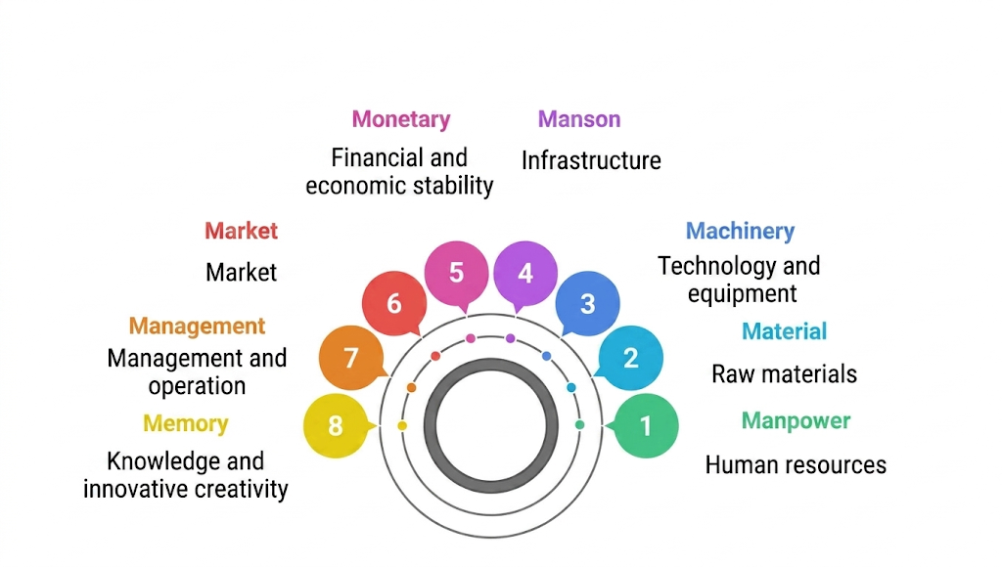
8M Analysis:
Advantages and Investment Opportunities in Viet Nam

Slide 18
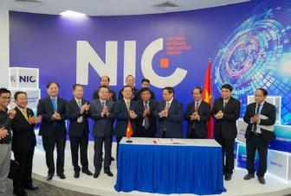
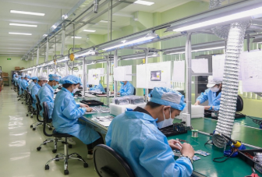
2.1 MANPOWER
01. > 51 million worker
02. High-tech engineers
  High and increasing proportion of young, skilled labor
  Vietnamese workers are recognized for their quick learning ability, diligence, and strong adaptability to modern work environments and technology
  Shift from unskilled labor to high-quality technical labor
  Viet Nam ranks among the top 10 countries in Asia with the highest number of IT engineers (nearly 530,000 people)
03. Government, Enterprises
04. Semiconductor industry workforce
  The government implements vocational education programs linked with enterprises, supporting resources, technology development, and digital skills.
  Enterprises invest in internal workforce training and establish their own training schools, such as Viettel, VinGroup, FPT, etc.
  The 2024–2030 goal is to train 50,000 engineers and graduates in the semiconductor industry.
  Develop data research centers, policies to nurture and attract talent.
  Establish a network connecting domestic and international experts.

Slide 19
Resolution No. 68-NQ/TW
Guiding Principles
Goals
1 2 3 4 5
Comprehensive leadership of the Party
Institutional breakthroughs
Laws aligned with practical realities
Enhancing the effectiveness of law enforcement
Investing in law-making and legislative development
Build a legal system that is democratic, fair, coherent, unified, transparent, public, and feasible.
Mobilize all citizens and businesses to participate in socio-economic development.
By 2030, Viet Nam will be a developing country with a modern industrial base and upper-middle income.
Remove practical obstacles and barriers, paving the way for innovation and development.
Objectives
Timeline
Renew legislative thinking and build a culture of legal compliance
Invest resources in legal and legislative work
Establish a Central Steering Committee for institutional and legal development
Build a legal ecosystem centered on citizens and businesses
2025
Complete the removal of legal “bottlenecks” caused by regulatory provisions.
2027
Complete the revision, supplementation, and issuance of legal documents to ensure a coherent legal framework for the operation of the state apparatus under the three-tier government model.
2028
Complete the legal framework on investment and business, contributing to placing Viet Nam’s investment and business environment among the top three in ASEAN.
2045
Viet Nam will have a modern, high-quality, and effective legal system that aligns with advanced international standards and practices while remaining suited to domestic realities.
Urgently revise and supplement legal documents to meet the requirements of streamlining the organizational apparatus of the political system and reorganizing administrative units, in conjunction with maximum decentralization and delegation of authority under the principle of “localities decide, localities implement, and localities take responsibility,” while restructuring the development space in each locality.
14

Slide 20

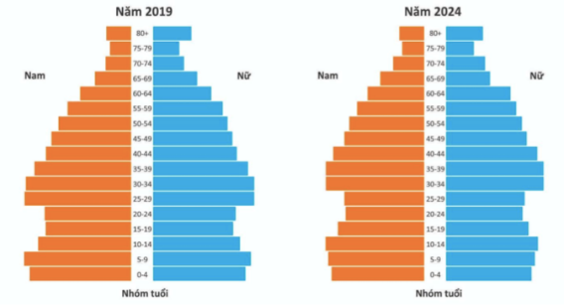
2.2 MARKET
Competitive production costs
A domestic market of over 100 million people, with a rapidly growing middle class and a young population structure
Diverse FTAs, providing access to markets in more than 60 countries, including the EU, Japan, and Canada
An attractive destination for businesses seeking to expand supply chains and market presence in the ASEAN region
The proportion of workers with formal qualifications increased from 12.5% in 2005 to 24.6% in 2021.
Approximately 40,000 skilled workers are trained abroad each year.
More than 102,3 billion people (2025)
67,4% population in the age of 15-64

Slide 21


E-commerce platforms are booming: Shopee, Lazada, Tiki, TikTok Shop… are rapidly expanding in both scale and features
The emergence of super apps integrating services such as e-wallets, banking, delivery, shopping, and entertainment
Cashless payments are on the rise: QR codes, e-wallets, and bank transfers. By 2024, digital payments account for over 75% of consumer transactions in urban areas
Vietnamese enterprises are accelerating digital transformation, integrating digital technologies to improve efficiency and reduce costs
AI is being applied in customer service (chatbots), consumer data analytics, and operational optimization
The rise of digital banking and AI-powered CRM systems
Factors | 2022 | 2023 | 2024 | 2025
Total retail sales | 5.679,9 thousand billion VND | 6.231,8 thousand billion VND | 6.391,0 thousand billion VND | 7.093 thousand billion VND
Retail e-commerce market size | 16,4 billion USD | 20,5 billion USD | 25 billion USD | 32 billion USD

Slide 22
Proactive global integration
Free trade agreements that Viet Nam has signed and will participate
No. | FTA | Partners
1 | AFTA | ASEAN
2 | ACFTA | ASEAN, China
3 | AKFTA | ASEAN, Korea
4 | AJCEP | ASEAN, Japan
5 | VJEPA | Viet Nam, Japan
6 | AIFTA | ASEAN, India
7 | AANZFTA | ASEAN, Australia, New Zealand
8 | VCFTA | Viet Nam, Chile
9 | VKFTA | Viet Nam, Korea
10 | VN – EAEU FTA | Viet Nam, Russia, Belarus, Amenia, Kazakhstan, Kyrgyzstan
11 | CPTPP Predecessor: the Trans-Pacific Partnership (TPP) | Viet Nam, Canada, Mexico, Peru, Chile, New Zealand, Australia, Japan, Singapore, Brunei, Malaysia, United Kingdom
12 | AHKFTA | ASEAN, Hong Kong

Slide 23
13 | EVFTA | Viet Nam, EU (28 members)
14 | UKVFTA | Viet Nam, United Kingdom
15 | RCEP | ASEAN, China, Korea, Japan, Australia, New Zealand
16 | VIFTA | Viet Nam, Israel
17 | CEPA | Viet Nam, UAE
FTAs under negotiation
17 | Viet Nam – EFTA FTA | Negotiations launched in May 2012 | Viet Nam and the EFTA countries (Switzerland, Norway, Iceland, and Liechtenstein)
18 | ASEAN - Canada | Negotiations resumed in November 2021 | ASEAN - Canada

Slide 24
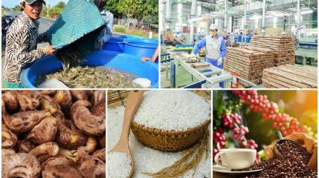
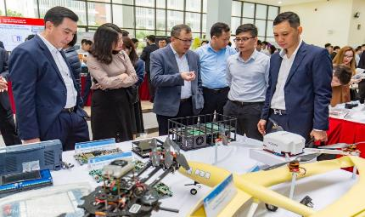
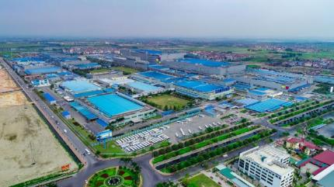
2.3 MATERIAL
The government is promoting the localization of raw materials to reduce dependence on imports.
  Viet Nam has natural advantages in raw materials across agriculture (rice, coffee, pepper, rubber), textiles (fiber, fabric), and minerals (bauxite, titanium, rare earths)
  Abundant resources support key export industries such as agro-processing, garments, footwear, and construction materials
  Supporting industries are developing: provinces such as Bac Ninh, Vinh Phuc, Ho Chi Minh City, and Binh Duong have formed industrial clusters supplying components and semi-finished goods to FDI enterprises

Slide 25
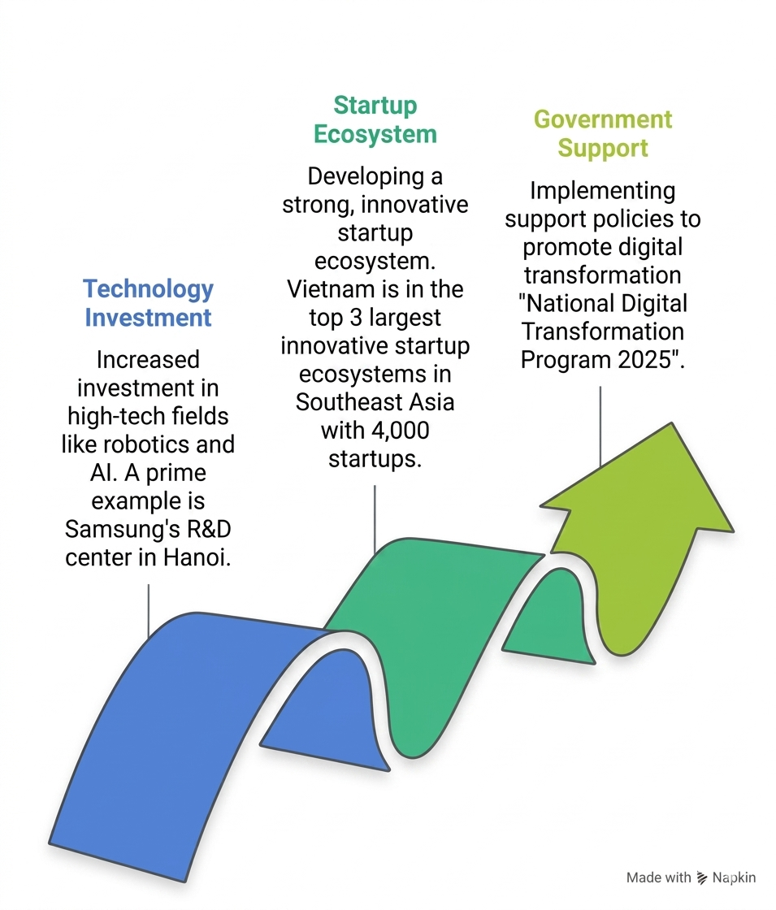
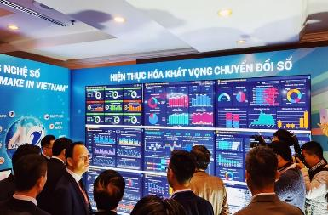

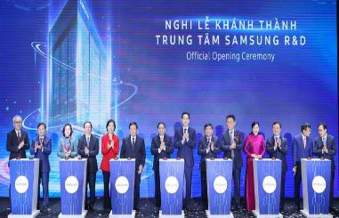

2.4 MACHINERY

Slide 26
Resolution No. 57 NQ/TW
Goals in 2030
Goals in 2045
International standing
Development indicators
Vision to 2045
Science, technology, and innovation capacity & capabilities
Viet Nam becomes a developed, high-income country
The digital economy accounts for at least 50% of GDP
Becomes a regional and global hub for the digital technology industry
Ranks among the top 30 globally in innovation and digital transformation
At least 10 digital technology companies operate at an international level
Attracts at least five major global technology corporations to invest in Viet Nam
Among the top 3 in Southeast Asia in AI and e-government
Ranked in the top 50 globally in digital competitiveness and e-government
At least five digital technology companies operating at an international level
Total Factor Productivity (TFP) contributes over 55% of economic growth
The digital economy accounts for at least 30% of GDP; high-tech exports reach at least 50%
Online public services account for at least 80%; cashless transactions reach at least 80%
At least 40% of enterprises engage in innovation activities
The Human Development Index (HDI) is maintained at ≥ 0.7
Science and technology levels have reached advanced standards in many fields
Vietnamese enterprises have achieved above-global-average technological capabilities
Several industries have reached international standards
Investment in science and technology
Human resources & institutions
The political system operates in a digitalized manner.
R&D spending reaches 2% of GDP; socialized funding accounts for over 60%
At least 3% of the annual state budget is allocated to science and technology and digital transformation
At least 12 researchers per 10,000 people
40–50 science and technology organizations ranked at regional or international levels
Patents: growth of 16–18% per year; commercialization rate: 8–10%
Ensure full connectivity and sharing of national and sectoral databases
Establish data exchange platforms and promote fair digital governance
Position Viet Nam among the leading countries in cybersecurity and data governance
10

Slide 27
2.5 MANSON – INFRASTRUCTURE
VIET NAM INFRASTRUCTURE DEVELOPMENT
NATIONAL PRIORITY PROJECTS
- North – South Expressway
- Long Thanh International Airport
- Lach Huyen Port Upgrade
- Cai Mep – Thi Vai Port Complex
SYNCHRONOUS INFRASTRUCTURE NETWORK
- Road Infrastructure
- Seaports
- Digital Infrastructure
SEAPORTS
- 11 Class-I Seaports.
- Modern Container Terminals
- International Connectivity

Slide 28
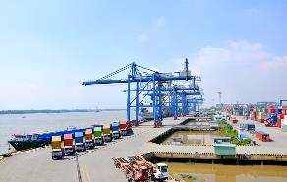
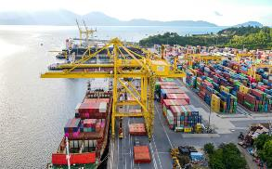
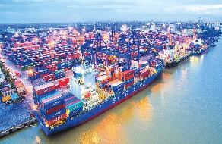
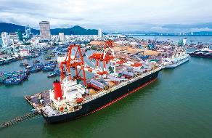
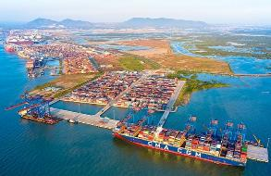
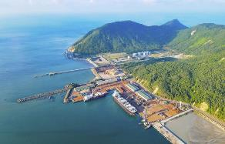
Some major port systems
1. Cát Lái Port (HCM city)
Close to major industrial zones and export processing zones (Cát Lái II Industrial Zone, Saigon Industrial Zone, etc.)
Can accommodate vessels up to 3,000 TEU and ships with a tonnage of over 20,000 DWT.
4. Đà Nẵng Port (Central Viet Nam)
Transshipment hub for goods from the Central Highlands, Laos, and Cambodia via the East–West Economic Corridor.
Can accommodate container ships of 50,000 DWT, general cargo ships of 70,000 DWT, and passenger ships of 170,000 GT
2. Hải Phòng Port (Hải Phòng City)
The main import-export gateway of the Northern region.
Lạch Huyện Port (part of Hải Phòng Port) is the first deep-water port in the North, capable of accommodating large vessels up to 100,000 DWT
5. Quy Nhơn Port (Bình Định)
An international general cargo port, the largest in the South Central Coast region.
Can normally accommodate vessels up to 30,000 DWT; vessels of 50,000 DWT can enter with reduced load.
3. Cái Mép – Thị Vải Port (Bà Rịa – Vũng Tàu)
An international deep-water port, capable of accommodating ultra-large container vessels over 200,000 DWT.
The only port in Viet Nam with direct shipping routes to Europe and the America
6. Vũng Áng – Sơn Dương Port (Hà Tĩnh)
A deep-water seaport serving the North Central region and heavy industries.
Can accommodate container vessels of up to 4,000 TEU.

Slide 29



Viet Nam is also an attractive investment destination for the manufacturing sector among ASEAN countries.
Besides competitive advantages in labor and the business environment, geographical location is one of the factors contributing to attracting investment.
Low labor costs
Location close to Korea
Business-friendly environment with smooth export procedures
Labor cost advantages compared to other ASEAN countries
Advantage of proximity to a major consumer and manufacturing market, Korea
Advantage of exporting through FTA/EPA agreements
AFTA | 11,1%
ACFTA | 22,6%
AKFTA | 12,9%
AJCEP | 7,7%
VJEPA | 7,7%
AANZFTA | 1,8%
AIFTA | 2,2%
VCFTA | 0,2%
VKFTA | 12,9%
VN-EAEUFTA | 0,9%
CPTPP | 12,5%
AHKFTA | 1,6%
EVFTA | －
China
Thailand
Phillipines Malaysia Indonesia
Viet Nam
Cambodia
Laos
Myanmar
384
335
331
297
297
中国
タイ フィリピン マレーシア
インドネシア
ベトナム カンボジア
192
190
120
103
200
0
400 600

Slide 30





STRAGIC GEOGRAPHICAL LOCATION
From 3-5 hours
To Japan, South Korea, China, Thailand…
Other nations
Connectivity hub between the Asia–Pacific region and countries on the western side of the Indochina Peninsula

Slide 31
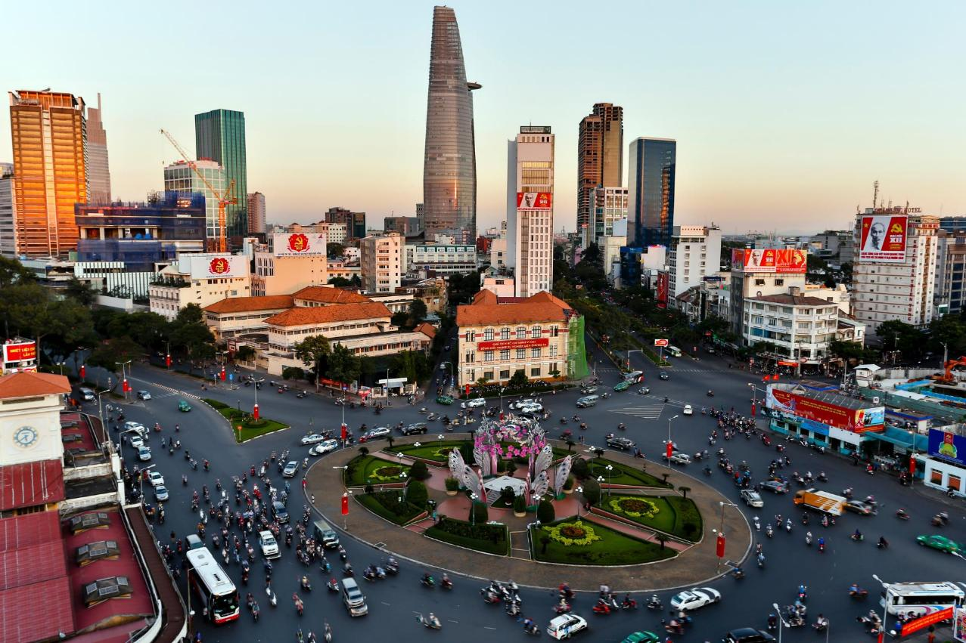
2.6 MONETARY
Export share significantly higher than other ASEAN countries, coupled with favorable growth dynamics
Export share fluctuations of five ASEAN countries (%)
Foreign exchange reserve fluctuations of five ASEAN countries
100
300,000
90
80
250,000
70
60
200,000
50
150,000
40
30
100,000
20
10
50,000
0
1 2 3 4 5 6 7 8 9 10 11 12 13 14 15 16
Viet Nam (2005-)
0
ベトナム(2005-)
Indonesia (1992-)
Thailand (1980-)
Malaysia (1973-)
インドネシア(1992-)
マレーシア (1973-)
Philippines (1979-)
Thái Lan
Malaysia
Philippines
Indonesia
ィリピン (1979-)
タ イ (1980-)
Việt Nam
ベトナム
タイ
マレーシア
フィリピン
インドネシア
Note: This represents the share of GDP. Viet Nam’s fluctuations are calculated from 2005, while for other countries, they are measured from the year when average per capita GDP exceeded the common benchmark of 600 USD.

Slide 32
Maintain the trend of expanding foreign direct investment
Private sector investment and expansion (supplementary) during the COVID-19 pandemic continued to increase, indicating signs of confidence in the investment environment.
FDI fluctuations by region
FDI fluctuations by new investment and expansion investment
(tỷ VND)
(triệu USD)
3,000,000
70,000 150%
2,500,000
60,000
100%
2,000,000
50,000
40,000
50%
1,500,000
30,000
0%
1,000,000
20,000
500,000
-50%
10,000
0
0
2006
2007
2008
2009
2010
2011
2012
2013
2014
2015
2016
2017
2018
2019
2020
2021
-100%
2010
2011
2012
2013
2014
2015
2016
2017
2018
2019
2020
新規
Khu vực nhà nước
Mới
Mở rộng
Tỷ lệ mở rộng so với năm trước
Khu vực tư nhân
Khu vực vốn nước ngoài

Slide 33



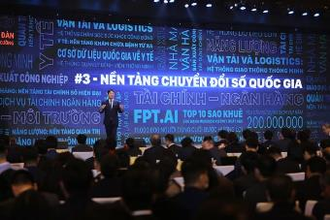


2.7 NATIONAL DIGITAL ECOSYSTEM
The government promotes an innovation ecosystem and develops the “Make in Vietnam” technology ecosystem: VSSID, VNeID, VNeID applications, etc
National digital transformation: Strong growth in level-4 online public services, with digitalization across all sectors of life (healthcare, culture, education, etc.)
1
2
The government promotes an innovation ecosystem and develops the “Make in Vietnam” technology ecosystem: VSSID, VNeID, VNeID applications, etc
- Encourage businesses to adopt circular economy models, clean technologies, and green production.
- Reduce total greenhouse gas emissions by at least 15% compared to the business-as-usual (BAU) scenario by 2030
3
4

Slide 34

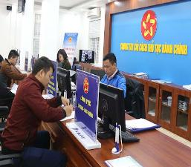
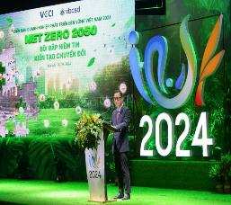
2.8 MANAGEMENT
Positive assessments from international organizations regarding the investment environment:
Participation in international commitments for sustainable development: COP26 – achieving net-zero emissions by 2050 → fostering a sustainable investment environment.
Strong incentives for high-tech, green, and sustainable industries (10% corporate income tax, corporate income tax exemptions for up to 15 years, etc.).
Proactively attract and selectively cooperate with foreign investment, using quality, efficiency, technology, and environmental protection as the main evaluation criteria.
Reform administrative procedures and eliminate unnecessary business conditions.

Slide 35
Resolution No. 66- NQ/TW
Guiding Principles
Goals
1 2 3 4 5
Comprehensive leadership of the Party
Institutional breakthroughs
Laws aligned with practical realities
Enhancing the effectiveness of law enforcement
Investing in law-making and legislative development
Build a legal system that is democratic, fair, coherent, unified, transparent, public, and feasible.
Mobilize all citizens and businesses to participate in socio-economic development.
By 2030, Viet Nam will be a developing country with a modern industrial base and upper-middle income.
Remove practical obstacles and barriers, paving the way for innovation and development.
Target
Roadmap
Renew legislative thinking and build a culture of legal compliance
Invest resources in legal and legislative work
Establish a Central Steering Committee for institutional and legal development
Build a legal ecosystem centered on citizens and businesses
2025
Complete the removal of legal “bottlenecks” caused by regulatory provisions.
2027
Complete the revision, supplementation, and issuance of legal documents to ensure a coherent legal framework for the operation of the state apparatus under the three-tier government model.
2028
Complete the legal framework on investment and business, contributing to placing Viet Nam’s investment and business environment among the top three in ASEAN.
2045
Viet Nam will have a modern, high-quality, and effective legal system that aligns with advanced international standards and practices while remaining suited to domestic realities.
Urgently revise and supplement legal documents to meet the requirements of streamlining the organizational apparatus of the political system and reorganizing administrative units, in conjunction with maximum decentralization and delegation of authority under the principle of “localities decide, localities implement, and localities take responsibility,” while restructuring the development space in each locality.
14

Slide 36
Strategy and Preparation of Viet Nam
Create a favorable legal framework
Tax incentives | Corporate income tax incentives are stipulated under current laws (Investment Law 2020, Corporate Income Tax Law, and Decree No. 218/2013/ND-CP). | Special incentives as stipulated under Investment Law No. 61/2020/QH14.
(1) Tax incentive duration | 10% tax rate for 30 years | 5% tax rate for a maximum period of 37 years
(2) Tax exemption | Tax exemption for 4 years, followed by a 50% tax reduction for the next 9 years | Tax exemption for up to 6 years, with a maximum 50% tax reduction for up to 13 years
(3) Requirements | Based on investment incentive sectors. Based on investment incentive locations. Based on a minimum project size of VND 6,000 billion with at least VND 6,000 billion disbursed within 3 years. | Investment projects with significant impacts on socio-economic development. Projects with investment capital exceeding VND 30,000 billion. Innovation centers, Research and Development (R&D) centers, etc. Additional requirements regarding advanced technology, the participation rate of Vietnamese enterprises in the supply chain, and the production ratio of Vietnamese enterprises.
(4) Legal basis | Articles 15 and 16 of the Investment Law 2020, the Corporate Income Tax Law, and relevant Decrees.. | Clause 4, Article 75 of Investment Law No. 61/2020/QH14

Slide 37
Corporate Income Tax Law
(No. 67/2025/QH15, effective from October 1, 2025, and applicable to the 2025 tax period)
Tax exemption for 2 years
Tax reduction for 4 years
17% tax rate for 10 years
For investment projects located in economic zones where the project site spans both tax-incentivized and non-incentivized areas, the determination of applicable tax incentives shall be prescribed by the Government.
The first year of applying tax incentives is calculated from the year the enterprise is granted the certificate or confirmation of incentives.
For foreign enterprises without a permanent establishment in Viet Nam:
Tax on income from capital transfer activities (both direct and indirect) may be calculated using a percentage rate on revenue.

Slide 38
Foreign Investment Cooperation Orientation
Resolution No. 50-NQ/TW of the Politburo
Prioritize projects using advanced, new, high and clean technologies; modern governance; high added value; strong spillover effects and technology transfer; and intergration into global production and supply chains
Proactively attract and corporate with foreign investment selectively, prioritizing quality, efficiency, technology and environmental protection as key evaluation criteria
The foreign-invested sector is an important component of the economy and should be encouraged, with conditions created for long-term development, cooperation, and healthy competition with other economic sectors
+123-456-7890

Slide 39
Preparation to Receive the Shift of FDI Flows
Proactively attract and cooperate with foreign investment selectively, taking quality, efficiency, technology, and environmental protection as the main evaluation criteria.
1
Prioritize projects with advanced, new, high, and clean technologies; modern governance; high added value; strong spillover effects and technology transfer; and integration into global production and supply chains.
2

Slide 40
Viet Nam’s Strategy and Preparation
FDI Cooperation Strategies
FDI inflows
1. Industrial real estate
2. Training
3. Energy
4. Supporting industries development
5. Developing a more attractive and favorable institutional framework
6. Specialized task forces to resolve business difficulties
1
2
Prioritize projects with new, high, and green technologies; modern governance systems; strong spillover effects; technology transfer and integration into global supply and value chains
Proactively and selectively attract and integrate foreign investment based on quality, eficiency, technological advancement, and enviromental frendliness

Slide 41
Viet Nam’s Strategy and Preparation
Creating a Favorable Legal Framework
- Establish open-door mechanisms
- Strengthen decentralization
- Clarify and diversify investment forms
- Supplement investment incentives and support policies
Law on Investment (June 17, 2020)
Law on Enterprises (June 17,2020)
Law on public-private partnership investment (June 18,2020)

Slide 42
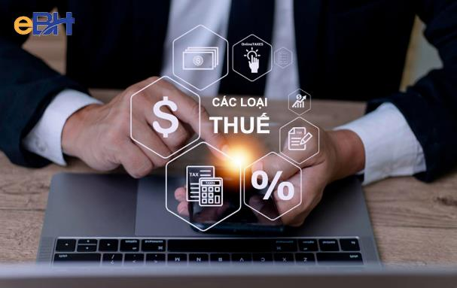
Overview of Tax Types in Viet Nam
01
Value Added Tax (VAT)
02
Corporate Income Tax (CIT)
03
Import and Export Tax
04
Foreign Contractor Tax (FCT)
05
Natural Resource Tax
06
Personal Income Tax (PIT)
07
Special Consumption Tax (SCT)
08
Non-Agricultural Land Use Tax
09
Business License Tax
10
Environmental Protection Tax

Slide 43
For large-scale investment projects
Enterprises with investment projects must satisfy all of the following conditions:
The project must fall within specific sectors or industries, such as high technology, information technology (IT), supporting industries, renewable energy, advanced materials, etc.
The total investment capital must be at least VND 10,000 billion (~USD 400 million).
At least VND 10,000 billion (~USD 400 million) must be disbursed within 3 years from the date of issuance of the Investment Registration Certificate or the investment policy approval decision.
Corporate Income Tax (CIT) incentives:
Preferential CIT rate of 9% for 30 years
CIT exemption for 5 years, followed by a 50% reduction for the subsequent 10 years
Exemption from land and water surface rental for 18 years, with a 55% reduction for the remaining project duration
New investment projects (including expansions) for Innovation Centers or Research and Development (R&D) Centers:
Minimum total investment capital of VND 3,000 billion, of which at least VND 1,000 billion (~USD 38 million) must be disbursed within 3 years from the date of issuance of the Investment Registration Certificate or investment approval decision.
Innovation centers must be established under a decision of the Prime Minister.
Corporate Income Tax (CIT) incentives:
Preferential CIT rate of 7% for 33 years
CIT exemption for 6 years, followed by a 50% reduction for the subsequent 12 years
Exemption from land and water surface rental for 20 years, with a 65% reduction for the remaining project duration

Slide 44

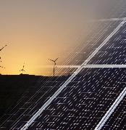



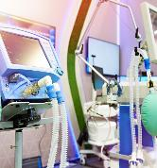

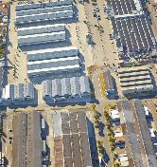
Potential sectors and industries attracting relocating FDI flows
Science and technology;
high technology; innovation
Energy sector (clean energy, renewable energy)
Supporting industries
Digital economy; digital transformation; green economy
Green and sustainable economic zones/industrial parks
E-commerce and logistics
Healthcare; medical devices
Retail and consumer sector

Slide 45


Viet Nam in partners’calculator

Slide 46






Viet Nam – an attractive investment destination
The EuroCham Business Confidence Index (BCI) reached 52.8 in Q1, the highest in the past two years. In the long term, 71% of businesses feel positive about prospects over the next five years. “Viet Nam has become an ideal investment destination in the region with proactive, investor-centric policies, which will further drive multifaceted development in the country.”
A survey by JETRO (Japan External Trade Organization) on business expansion trends ranked Viet Nam as the preferred destination for expanding operations in ASEAN, with over 60% of Japanese companies planning to continue expanding in Viet Nam in the future.
Viet Nam’s business environment ranking, according to the World Bank, improved by 20 positions between 2016 and 2020, placing it among the top 5 in ASEAN today.
Moody's, Standard & Poor's, and Fitch Ratings all assess Viet Nam’s sovereign credit outlook as “positive.”
Viet Nam ranks 44th in the Global Innovation Index (2024), up 19 positions since 2016.

Slide 47






























































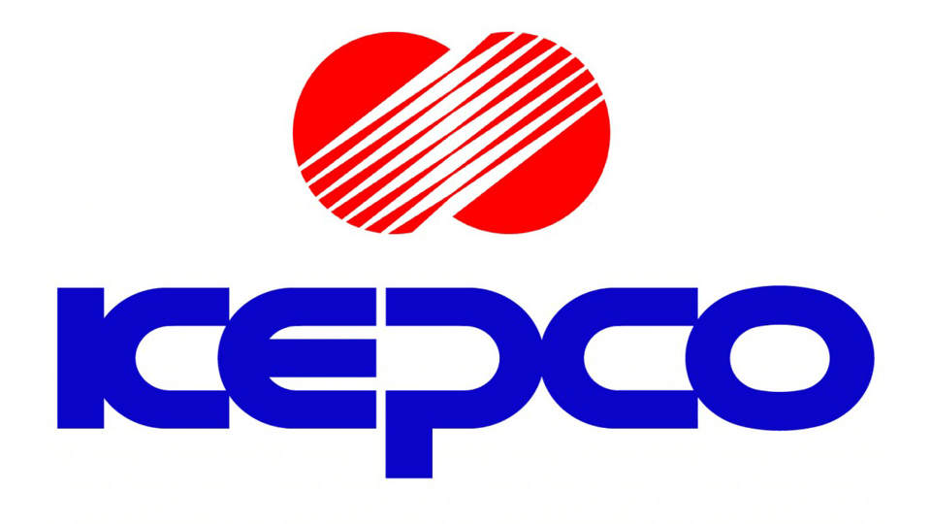






LARGE CORPORATIONS INVESTING IN VIET NAM

Slide 48
ANNEX
COUNTRY FACT

Slide 49
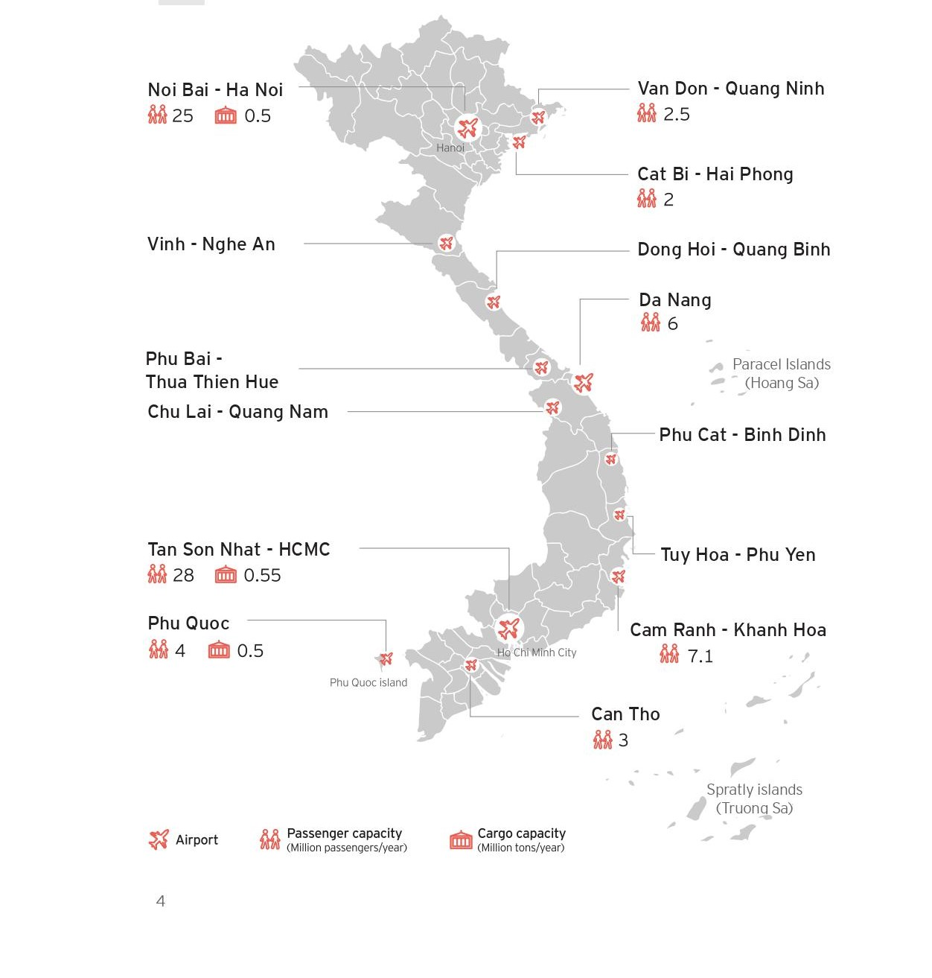
Airport

Slide 50
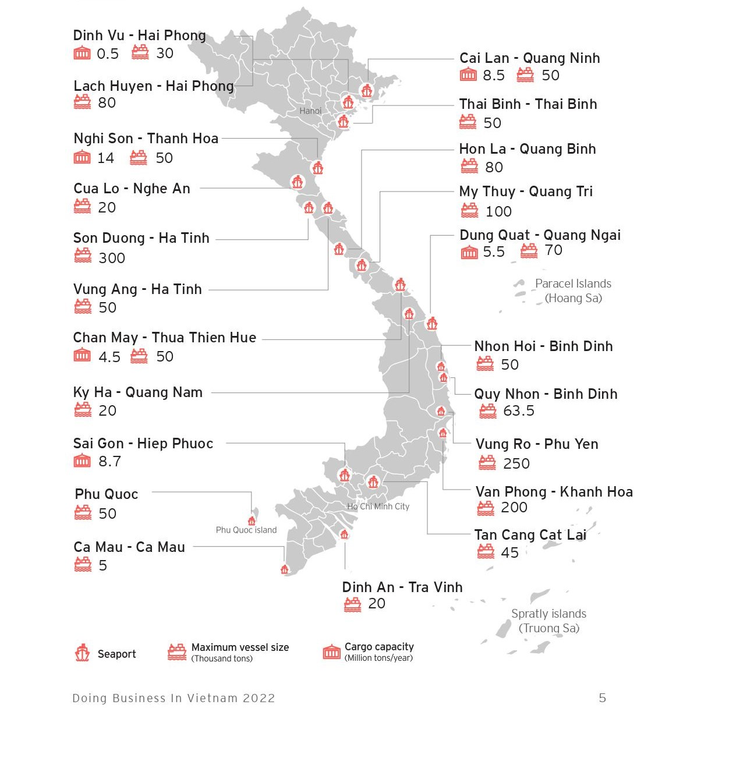
Seaport

Slide 51
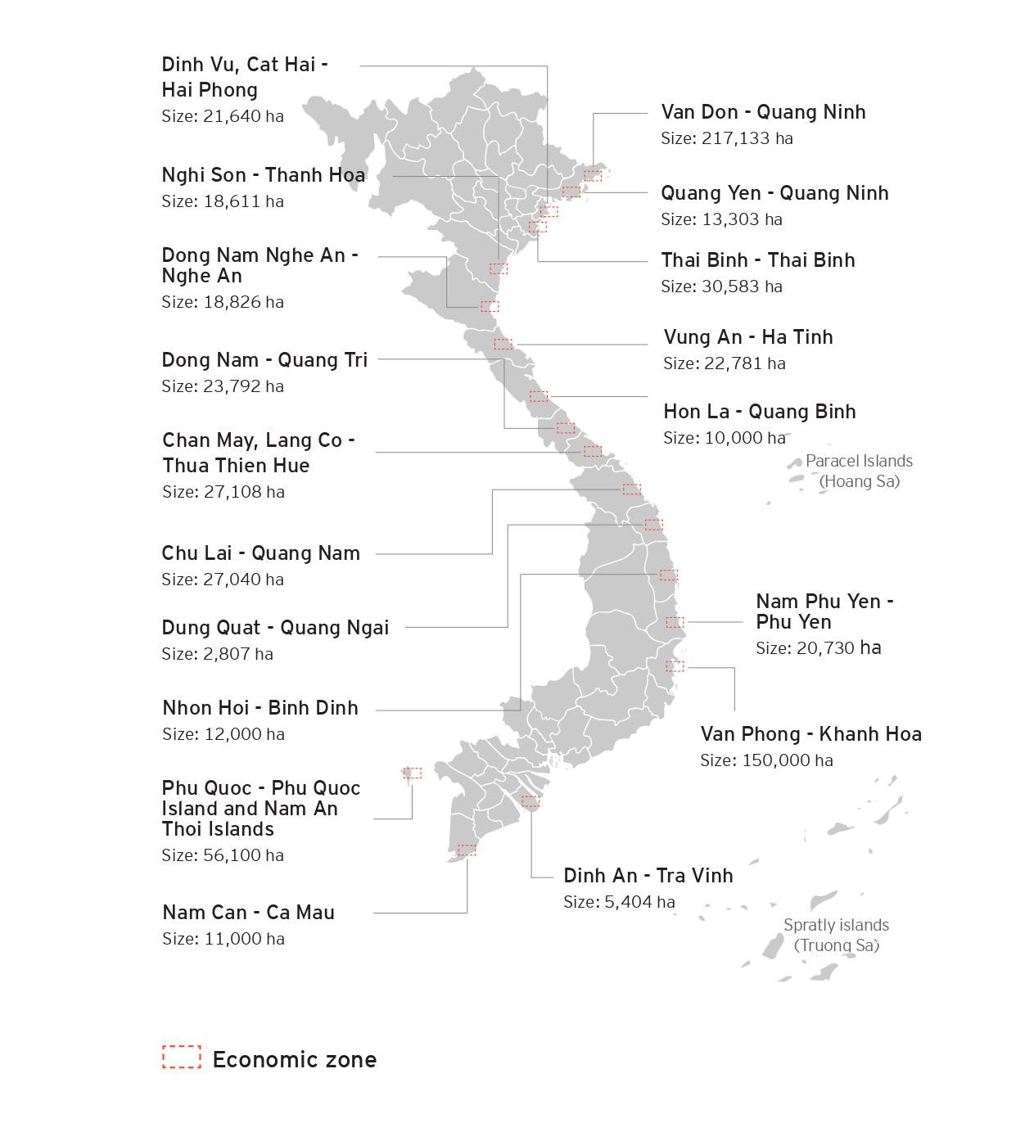
Coastal
Economic
Zones

Slide 52







THANK YOU FOR YOUR ATTENTION !
THANK ALL RESEARCHERS FOR YOUR CLOSE COOPERATION AND SUPPORT !
.
https://vn-eu-tradehub.com/
BE@moit.gov.vn
Viet-Nam-Trade-Office-to-Belgium-EU-
and-Luxembourg
@ Vietnam Eu

